Slide 1
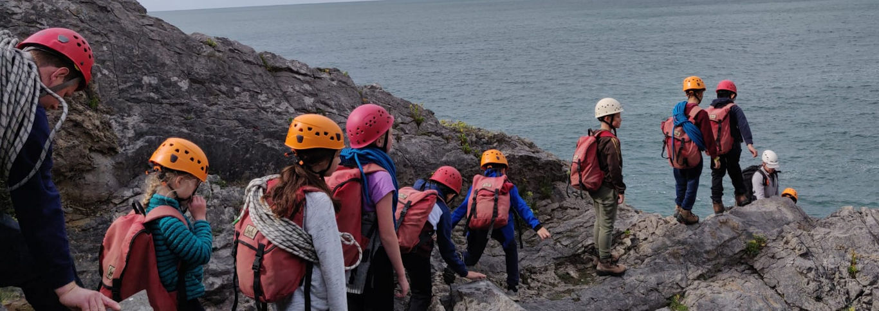
St Joseph’s Catholic Primary School
What are you looking for from us as head -
teachers to ensure pupil and school success?
Please share your thoughts.

Slide 2
St Joseph’s Catholic Primary School
Aims
- School mission
- Remit and Introductions
- Priorities for interim period
- Partnerships and community

Slide 3
St Joseph’s Catholic Primary School
Walking in the footsteps of Jesus. Loving and serving together.
St Joseph’s Primary School

Slide 4
St Joseph’s Catholic Primary School
Our remit (August 2023):
HT absence: Invitation and capacity to support St Joseph’s.
Aim: Provide leadership and operational stability Day to day and in the interim with a possible eye to future. Catholic school assuredness.
Agreement: Day to day operational & strategic. Decoupled from IEB processes linked to past years.

Slide 5
St Joseph’s Catholic Primary School
Introductions: Karen Bathe
Co-head at Holy Family, Swindon.
Practising Catholic.
12 years HT experience.
Chair of Samuel Partnership (St Joseph’s Catholic Partnership).
Adoptive parent of two children.
Maths consultant experience.

Slide 6
St Joseph’s Catholic Primary School
Introductions: Paul Bacon
4 HT roles (international, rural & town schools).
Experience of co-headship.
Not catholic but committed to church school and Catholic education.
Mature family - primary and secondary education.
Wider and broad, balanced and hands on curriculum interests.

Slide 7
St Joseph’s Catholic Primary School
Priorities
Ethos: Spiritual dimension
Virtues
of Love and Joy
St Joseph’s is
a Good
School
Teaching and learning.
Strong Community
Core purpose:
wider leadership
Bishop’s challenge:
Outward looking

Slide 8
St Joseph’s Catholic Primary School
Spiritual Dimension:
Virtues of Love and Joy
Overview of current virtues (on hold)
Key virtues to enable the foundation of community growth
Worship themes each week (Gospel KB and Virtues PB).

Slide 9
St Joseph’s Catholic Primary School
Teaching and learning:
The school’s core purpose beyond the spiritual dimension:
Enable the teachers to concentrate on T&L
Aspiration through the curriculum (oversight)
Enabling and developing leaders (progression from Ofsted 2023)

Slide 10
St Joseph’s Catholic Primary School
Partnership and Community:
- Parent Forum (Wednesday’s 08:50) Dates TBC
Newsletter
Chaplaincy / School Council – Pupil voice
Parish
PTA linking and planning
Wider community link planning
Links to other schools and networks

Slide 11
St Joseph’s Catholic Primary School
Thank you for joining and supporting the school.

