Slide 1
LIFE/work balance
We have started a #LIFEworkbalance campaign and we need your help to complete our LIFE/work balance survey.
We hope to publish the results soon, so please give 15 minutes of your time to help us get a true picture of school life.
Want to be a part of this campaign? Take the survey on our website and share it with your colleagues!
© Classroom Secrets Limited 2019

Slide 2
Year 3 – Summer Block 4 – Prefixes – Adding ‘super-’, ‘anti-’ and ‘auto-’
Teaching Note:
For the purpose of this resource, we have only included root words which can stand alone as base words.
About This Resource:
This PowerPoint has been designed to support your teaching of this small step. It includes a starter activity and an example of each question from the Varied Fluency and Application and Reasoning resources also provided in this pack. You can choose to work through all examples provided or a selection of them depending on the needs of your class.
National Curriculum Objectives:
English Year 3: (3G6.2) Formation of nouns using a range of prefixes [for example super–, anti–, auto–]
Spelling: Spell more prefixes
Terminology for pupils:
(3G6.2) prefix
More resources from our Grammar, Punctuation and Spelling scheme of work.
Did you like this resource? Don’t forget to review it on our website.
© Classroom Secrets Limited 2019

Slide 3
Year 3 – Summer Block 4 – Prefixes – Adding ‘super-’, ‘anti-’ and ‘auto-’
Notes and Guidance:
In the previous step, children were reminded how the addition of a prefix to a root word changes the meaning of the word it belongs to without making any changes to the spelling of the root word itself.
In this step, children will use the prefixes ‘super-’, ‘anti-’ and ‘auto-’ and add these to root words to change their meaning.
‘Super-’ means above; ‘anti-’ means against and ‘auto-’ means self or own.
Children should be able to recognise how the prefix changes the meaning of the root word they add it to and be able to use these in their writing accurately.
Focused Questions
Add the prefix ‘super-’/ ‘anti-’/‘auto-’ to these words.
Why has the prefix ‘super-’/ ‘anti-’/‘auto-’ been added to this word? How does it change the meaning?
Which of these prefixes cannot be added to this word?
Complete the sentence using the correct prefix for the given word.
© Classroom Secrets Limited 2019

Slide 4
Year 3 – Summer Block 4 – Prefixes
Step 2: Adding ‘super-’, ‘anti-’ and ‘auto-’
© Classroom Secrets Limited 2019

Slide 5
Introduction
Complete the table below using the prefix ‘un’.
How does adding the prefix un- change the meaning of the root words?
Root word | Prefix + root word
happy
 | unkind
pack
tidy
© Classroom Secrets Limited 2019

Slide 6
Introduction
Complete the table below using the prefix ‘un’.
How does adding the prefix un- change the meaning of the root words?
When the prefix un is added to a word, it creates the opposite of the original word. The prefix un means not.
Root word | Prefix + root word
happy | unhappy
kind | unkind
pack | unpack
tidy | untidy
© Classroom Secrets Limited 2019

Slide 7
Varied Fluency 1
Tick to show which prefix could be added on to these root words.
Root word | super- | anti- | auto-
bodies
dial
store
© Classroom Secrets Limited 2019

Slide 8
Varied Fluency 1
Tick to show which prefix could be added on to these root words.
Root word | super- | anti- | auto-
bodies |  | ✓
dial |  |  | ✓
store | ✓
© Classroom Secrets Limited 2019

Slide 9
Varied Fluency 2
Fill in the blank with super, anti or auto.
Many people admired Juan, the experienced ice skater from Iceland, he was a _________ star in their eyes.
© Classroom Secrets Limited 2019

Slide 10
Varied Fluency 2
Fill in the blank with super, anti or auto.
Many people admired Juan, the experienced ice skater from Iceland, he was a _________ star in their eyes.
super
© Classroom Secrets Limited 2019

Slide 11
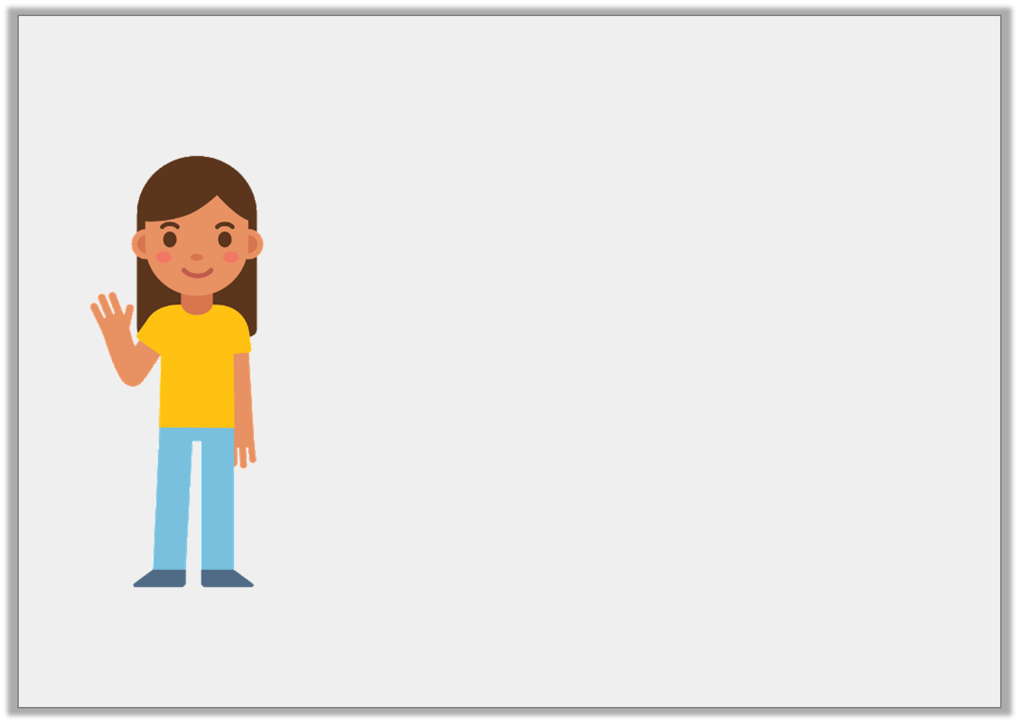
Varied Fluency 3
True or false?
Anticlockwise means that someone is racing against the clock.
© Classroom Secrets Limited 2019

Slide 12
Varied Fluency 3
True or false?
False, because the prefix anti means against so anticlockwise describes going in the opposite direction to clockwise.
Anticlockwise means that someone is racing against the clock.
© Classroom Secrets Limited 2019

Slide 13
Varied Fluency 4
Circle all the prefixes in the sentence below.
The antiheroes were determined to defeat the allies but their chances were slim as they had superhuman powers.
© Classroom Secrets Limited 2019

Slide 14
Varied Fluency 4
Circle all the prefixes in the sentence below.
The antiheroes were determined to defeat the allies but their chances were slim as they had superhuman powers.
© Classroom Secrets Limited 2019

Slide 15
Reasoning 1
Juliet thinks there is one prefix in the sentence below.
During her recent visit, Taylor Quick was surrounded by various people who wanted her autograph.
Do you agree with Juliet? Explain why.
© Classroom Secrets Limited 2019

Slide 16
Reasoning 1
Juliet thinks there is one prefix in the sentence below.
During her recent visit, Taylor Quick was surrounded by various people who wanted her autograph.
Do you agree with Juliet? Explain why.
Juliet is correct because…
© Classroom Secrets Limited 2019

Slide 17
Reasoning 1
Juliet thinks there is one prefix in the sentence below.
During her recent visit, Taylor Quick was surrounded by various people who wanted her autograph.
Do you agree with Juliet? Explain why.
Juliet is correct because the only prefix that has been used in this sentence is auto.
© Classroom Secrets Limited 2019

Slide 18
Application 1
Use each prefix once to complete the sentences below.
A. After falling off of his bike, Alexios was sent to the surgery where they applied ________biotic cream to his sore wound.
B. Sadly, many people are hurt in _____________mobile accidents in England each year.
C. As a child, Myles loved watching ______________hero films.
auto
super
anti
© Classroom Secrets Limited 2019

Slide 19
Application 1
Use each prefix once to complete the sentences below.
A. After falling off of his bike, Alexios was sent to the surgery where they applied ________biotic cream to his sore wound.
B. Sadly, many people are hurt in _____________mobile accidents in England each year.
C. As a child, Myles loved watching ______________hero films.
auto
super
anti
anti
auto
super
© Classroom Secrets Limited 2019

Slide 20
Reasoning 2
Read the sentence below.
The mechanic explained that the car’s autopilot system was faulty and it would need repairing.
Does this sentence still make sense if you change the underlined prefix to anti?
Explain how you know.
© Classroom Secrets Limited 2019

Slide 21
Reasoning 2
Read the sentence below.
The mechanic explained that the car’s autopilot system was faulty and it would need repairing.
Does this sentence still make sense if you change the underlined prefix to anti?
Explain how you know.
This sentence will not make sense because…
© Classroom Secrets Limited 2019

Slide 22
Reasoning 2
Read the sentence below.
The mechanic explained that the car’s autopilot system was faulty and it would need repairing.
Does this sentence still make sense if you change the underlined prefix to anti?
Explain how you know.
This sentence will not make sense because anti + pilot = antipilot which is not a real word.
© Classroom Secrets Limited 2019

