Slide 1


LIFE/work balance
We have started a #LIFEworkbalance campaign and we need your help to complete our LIFE/work balance survey.
We hope to publish the results soon, so please give 15 minutes of your time to help us get a true picture of school life.
Want to be a part of this campaign? Take the survey on our website and share it with your colleagues!
© Classroom Secrets Limited 2019

Slide 2
Year 3 – Summer Block 4 – Prefixes – Adding ‘sub-’, ‘inter-’
About This Resource:
This PowerPoint has been designed to support your teaching of this small step. It includes a starter activity and an example of each question from the Varied Fluency and Application and Reasoning resources also provided in this pack. You can choose to work through all examples provided or a selection of them depending on the needs of your class.
National Curriculum Objectives:
  English Year 3: (3G6.2) Formation of nouns using a range of prefixes [for example super–, anti–, auto–]
  Spelling: Spell more prefixes
  Terminology for pupils:
    (3G6.2) prefix
More resources from our Grammar, Punctuation and Spelling scheme of work.
Did you like this resource? Don’t forget to review it on our website.
© Classroom Secrets Limited 2019

Slide 3
Year 3 – Summer Block 4 – Prefixes – Adding ‘sub-’, ‘inter-’
Notes and Guidance
In the previous step, children used the prefixes ‘super-’, ‘anti-’ and ‘auto-’ and added these to root words to change the meaning.
In this step, children will recognise and use the prefixes ‘sub-’, ‘inter-’ and add these to words to create nouns.
‘Sub-’ means under; ‘inter-’ means among.
Children should be able to identify how the prefix changes the meaning of the root word they add it to and be able to use words with these prefixes accurately in their writing.
Focused Questions
Add the prefix ‘sub-’ or ‘inter-’ to these words.
Why has the prefix ‘sub-’ or ‘inter-’ been added to this word? How does it change the meaning?
Which of these prefixes cannot be added to this word?
Complete the sentence using the correct prefix for the given word.
© Classroom Secrets Limited 2019

Slide 4
Year 3 – Summer Block 4 – Prefixes
Step 3: Adding ‘sub-’, ‘inter-’
© Classroom Secrets Limited 2019

Slide 5
Introduction
Match the root words to the prefix.
super | anti | auto
star
freeze
clockwise
cue
graph
hero
store
model
© Classroom Secrets Limited 2019

Slide 6
Introduction
Match the root words to the prefix.
super | anti | auto
star
freeze
graph
store
clockwise
cue
hero
model
© Classroom Secrets Limited 2019

Slide 7
Varied Fluency 1
Match the prefix to the root word.
state
sub
weave
inter
marine
let
© Classroom Secrets Limited 2019

Slide 8
Varied Fluency 1
Match the prefix to the root word.
state
sub
weave
inter
marine
let
© Classroom Secrets Limited 2019

Slide 9
Varied Fluency 2
True or false? The prefix ‘inter’ can be added to both root words?
net | carrier
© Classroom Secrets Limited 2019

Slide 10
Varied Fluency 2
True or false? The prefix ‘inter’ can be added to both root words?
False. It cannot be added to the root word ‘carrier’.
net | carrier
© Classroom Secrets Limited 2019

Slide 11
Varied Fluency 3
Match the word to the meaning.
interplanetary
different races
subcompact
travelling between planets
interracial
very small
© Classroom Secrets Limited 2019

Slide 12
Varied Fluency 3
Match the word to the meaning.
interplanetary
different races
subcompact
travelling between planets
interracial
very small
© Classroom Secrets Limited 2019

Slide 13
Varied Fluency 4
Choose the correct word given below to complete each of the sentences.
The time between two wars is known as the ___________ period.
The building was supported by the _________________ .
substructure
interwar
© Classroom Secrets Limited 2019

Slide 14
Varied Fluency 4
Choose the correct word given below to complete each of the sentences.
The time between two wars is known as the ___________ period.
The building was supported by the _________________.
interwar
substructure
substructure
interwar
© Classroom Secrets Limited 2019

Slide 15
Application 1
Add ‘sub’ or ‘inter’ to the root word below and use it in a sentence with the words from the word bank.
due
superhero | enemy
protect | town
© Classroom Secrets Limited 2019

Slide 16
Application 1
Add ‘sub’ or ‘inter’ to the root word below and use it in a sentence with the words from the word bank.
Subdue.
Various answers, for example: The superhero was able to subdue the enemy threat and protect the town.
due
superhero | enemy
protect | town
© Classroom Secrets Limited 2019

Slide 17
Reasoning 1
Alice has written two sentences below.
Using the two sentences given, explain how the prefix has altered the meaning of the root word.
A. | The subscript was printed below the line.
B. | The actor read his script.
© Classroom Secrets Limited 2019

Slide 18
Reasoning 1
Alice has written two sentences below.
Using the two sentences given, explain how the prefix has altered the meaning of the root word.
The prefix ‘sub’ added to the root word ‘script’ alters the meaning of the word…
A. | The subscript was printed below the line.
B. | The actor read his script.
© Classroom Secrets Limited 2019

Slide 19
Reasoning 1
Alice has written two sentences below.
Using the two sentences given, explain how the prefix has altered the meaning of the root word.
The prefix ‘sub’ added to the root word ‘script’ alters the meaning of the word to mean text printed below the line rather than just text.
A. | The subscript was printed below the line.
B. | The actor read his script.
© Classroom Secrets Limited 2019

Slide 20
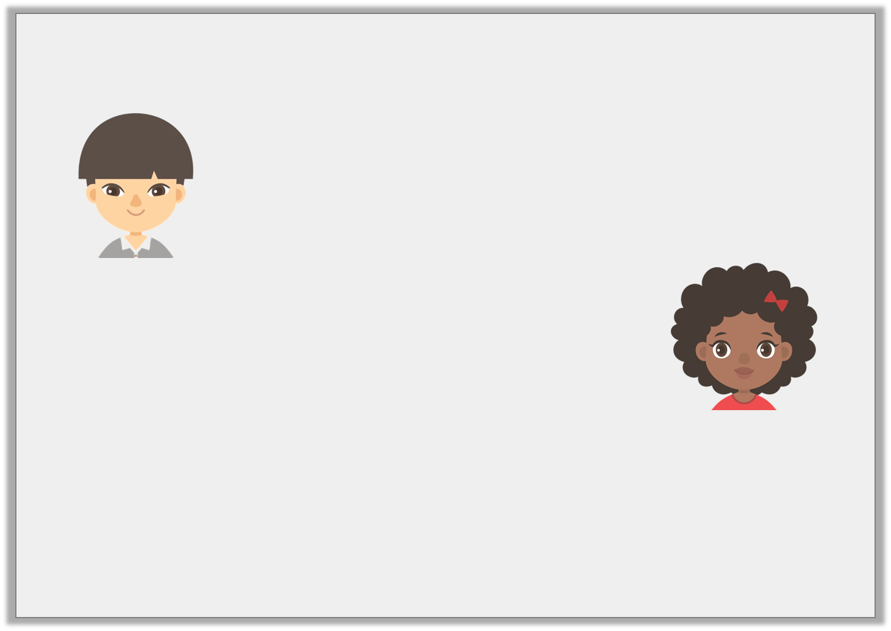
Reasoning 2
Tony and Luna are talking about the root word ‘sequence’.
Who is correct? Explain your answer.
You can add the prefix ‘sub-’ to this root word.
Tony
You can add the prefixes ‘sub-’ and ‘inter-’ to this root word.
Luna
© Classroom Secrets Limited 2019

Slide 21
Reasoning 2
Tony and Luna are talking about the root word ‘sequence’.
Who is correct? Explain your answer.
Tony is correct because…
You can add the prefix ‘sub-’ to this root word.
Tony
You can add the prefixes ‘sub-’ and ‘inter-’ to this root word.
Luna
© Classroom Secrets Limited 2019

Slide 22
Reasoning 2
Tony and Luna are talking about the root word ‘sequence’.
Who is correct? Explain your answer.
Tony is correct because ‘intersequence’ is not a word.
You can add the prefix ‘sub-’ to this root word.
Tony
You can add the prefixes ‘sub-’ and ‘inter-’ to this root word.
Luna
© Classroom Secrets Limited 2019

