Slide 1


LIFE/work balance
We have started a #LIFEworkbalance campaign and we need your help to complete our LIFE/work balance survey.
We hope to publish the results soon, so please give 15 minutes of your time to help us get a true picture of school life.
Want to be a part of this campaign? Take the survey on our website and share it with your colleagues!
© Classroom Secrets Limited 2019

Slide 2
Year 3 – Autumn Block 2 – Determiners – What is a Consonant?
About This Resource:
This PowerPoint has been designed to support your teaching of this small step. It includes a starter activity and an example of each question from the Varied Fluency and Application and Reasoning resources also provided in this pack. You can choose to work through all examples provided or a selection of them depending on the needs of your class.
National Curriculum Objectives:
  English Year 3: (3G1.8) Use the forms a or an according to whether the next word begins with a consonant or a vowel [for example, a rock, an open box]
  Terminology for pupils:
    (3G1.8) consonant
    (3G1.8) consonant letter
More resources from our Grammar, Punctuation and Spelling scheme of work.
Did you like this resource? Don’t forget to review it on our website.
© Classroom Secrets Limited 2018

Slide 3
Year 3 – Autumn Block 2 – Determiners – What is a Consonant?
Notes and Guidance
Children need to understand the term consonant which refers to the 21 consonant letters.
The English language includes 21 consonant letters and 24 consonant sounds.
The consonant sounds are produced when the speaker closes off or obstructs the flow of air through the vocal tract, usually using lips, tongue or teeth (further guidance can found in the Glossary for the programmes of study for English [non-statutory]).
Children should know that words are made up of both vowels and consonants apart from words that use the letter y as a vowel sound (covered in the previous step).
Focused Questions
Which letters are consonants?
What are the consonant sounds in these words? Are they spelt the same way?
© Classroom Secrets Limited 2018

Slide 4
Year 3 – Autumn Block 2 – Determiners
Step 2: What is a Consonant?
© Classroom Secrets Limited 2018

Slide 5
Introduction
Which of the following letters are consonants?
Which consonant is missing?
a | j | c | i | p
k | f | n | o | e
u | t | q | b | l
d | r | h | x | y
s | m | v | z | g
© Classroom Secrets Limited 2018

Slide 6
Introduction
Which of the following letters are consonants?
Which consonant is missing?
The consonant ‘w’ is missing.
a | j | c | i | p
k | f | n | o | e
u | t | q | b | l
d | r | h | x | y
s | m | v | z | g
© Classroom Secrets Limited 2018

Slide 7
Varied Fluency 1
Complete the words using the consonants below.
_lan_ | _ _ash
g | r | c | d
© Classroom Secrets Limited 2018

Slide 8
Varied Fluency 1
Complete the words using the consonants below.
gland | crash
g | r | c | d
© Classroom Secrets Limited 2018

Slide 9
Varied Fluency 2
Circle the letters which are consonants.
d | o | v | r
i | s | g | e
© Classroom Secrets Limited 2018

Slide 10
Varied Fluency 2
Circle the letters which are consonants.
d | o | v | r
i | s | g | e
© Classroom Secrets Limited 2018

Slide 11
Varied Fluency 3
Match the pairs of words that contain the same underlined consonant sound.
write |  | known |  | buzzes
always |  | carries |  | name
© Classroom Secrets Limited 2018

Slide 12
Varied Fluency 3
Match the pairs of words that contain the same underlined consonant sound.
write |  | known |  | buzzes
always |  | carries |  | name
© Classroom Secrets Limited 2018

Slide 13
Varied Fluency 4
Sort the words below into groups to show whether they have 2, 3 or 4 consonants in them.
floor | usual | should
pencil | travel | nicer
other | child | motion
© Classroom Secrets Limited 2018

Slide 14
Varied Fluency 4
Sort the words below into groups to show whether they have 2, 3 or 4 consonants in them.
2 consonants: usual
3 consonants: floor; nicer; other; motion
4 consonants: child; should; travel; pencil
floor | usual | should
pencil | travel | nicer
other | child | motion
© Classroom Secrets Limited 2018

Slide 15
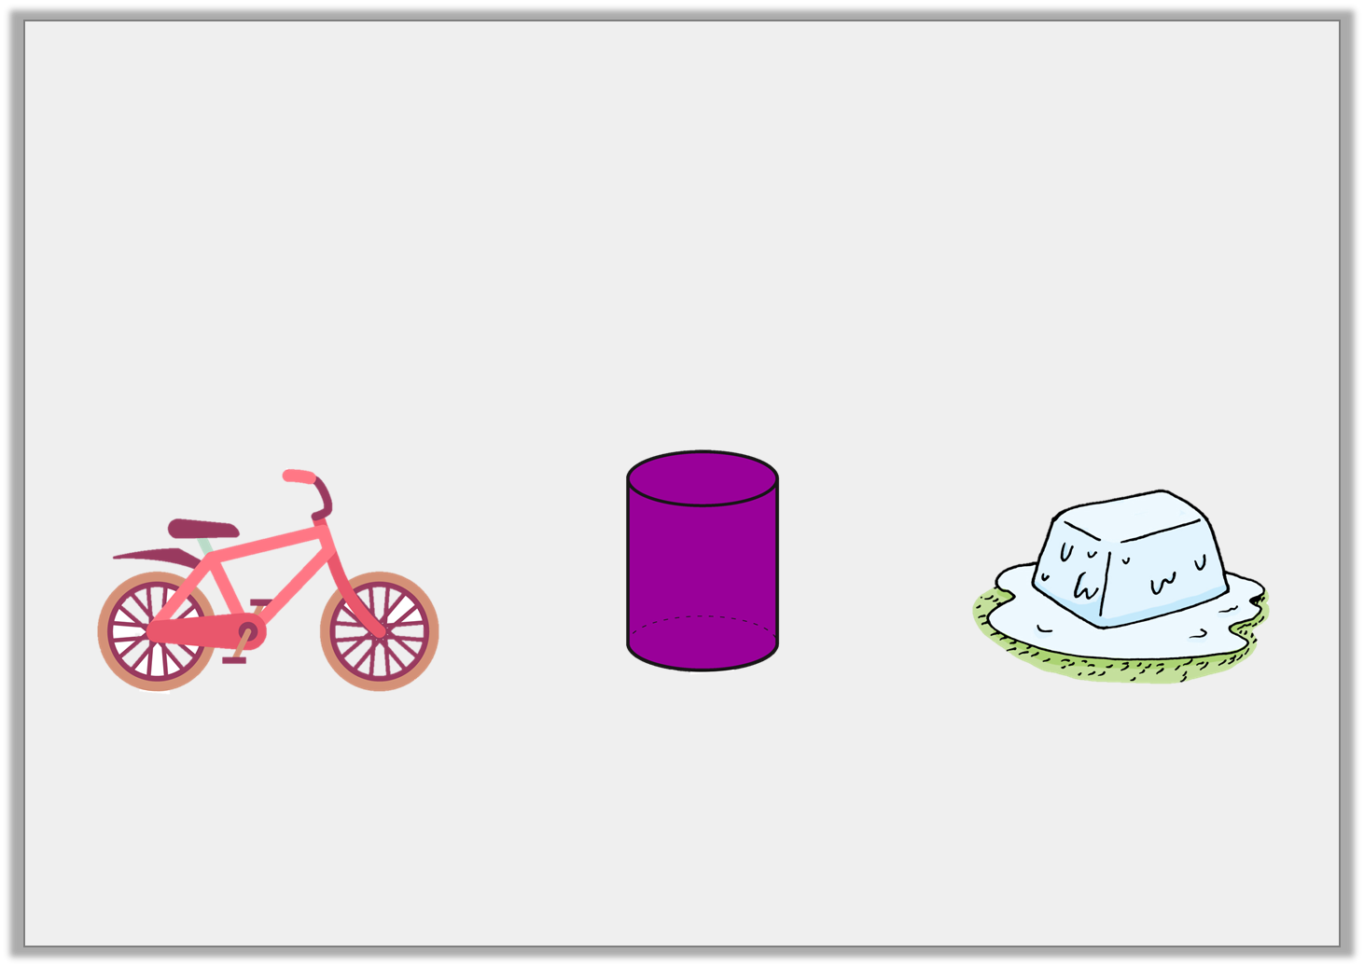
Application 1
How many sounds can these letters make?
The pictures might give you a clue.
List as many words as you can for each sound you think of.
cy
© Classroom Secrets Limited 2018

Slide 16
Application 1
How many sounds can these letters make?
The pictures might give you a clue.
List as many words as you can for each sound you think of.
Cycle, bicycle, cyclops = sounds like sigh
Cyclinder = sounds like si
Icy, juicy, fancy, emergency = sounds like see
cy
© Classroom Secrets Limited 2018

Slide 17
Application 2
Create 5 words using the consonants and vowels below. The words should contain at least 3 consonants and 1 vowel.
What is the longest word you can make?
f | n | s
a | t | a
y | c | i
© Classroom Secrets Limited 2018

Slide 18
Application 2
Create 5 words using the consonants and vowels below. The words should contain at least 3 consonants and 1 vowel.
What is the longest word you can make?
Various answers, for example: fast, fanatic; fancy; fantasy; ants; city.
Longest words are: sanctify or fanatics.
f | n | s
a | t | a
y | c | i
© Classroom Secrets Limited 2018

Slide 19

Reasoning 1
Tessa has these word cards.
She says,
Is she correct? Explain your reasoning.
learn
when
children
early
'Early’ is the odd one out because it starts with a vowel and doesn’t end in ‘n’.
© Classroom Secrets Limited 2018

Slide 20
Reasoning 1
Tessa has these word cards.
She says,
Is she correct? Explain your reasoning.
Tessa is incorrect because…
learn
when
children
early
'Early’ is the odd one out because it starts with a vowel and doesn’t end in ‘n’.
© Classroom Secrets Limited 2018

Slide 21
Reasoning 1
Tessa has these word cards.
She says,
Is she correct? Explain your reasoning.
Tessa is incorrect because ‘children’ is the odd one out. ‘Children’ has six consonants whereas ‘learn’, ‘when’ and ‘early’ have three.
learn
when
children
early
'Early’ is the odd one out because it starts with a vowel and doesn’t end in ‘n’.
© Classroom Secrets Limited 2018

