Slide 1

LIFE/work balance
We have started a #LIFEworkbalance campaign and we need your help to complete our LIFE/work balance survey.
We hope to publish the results soon, so please give 15 minutes of your time to help us get a true picture of school life.
Want to be a part of this campaign? Take the survey on our website and share it with your colleagues!

Slide 2

Year 3 – Autumn Block 2 – Determiners – What is a Vowel?
About This Resource:
This PowerPoint has been designed to support your teaching of this small step. It includes a starter activity and an example of each question from the Varied Fluency and Application and Reasoning resources also provided in this pack. You can choose to work through all examples provided or a selection of them depending on the needs of your class.
National Curriculum Objectives:
  English Year 2: (3G1.8) Use the forms a or an according to whether the next word begins with a consonant or a vowel [for example, a rock, an open box]
  Terminology for pupils:
    (3G1.8) vowel
    (3G1.8) vowel letter
More resources from our Grammar, Punctuation and Spelling scheme of work.
Did you like this resource? Don’t forget to review it on our website.
© Classroom Secrets Limited 2018

Slide 3
Year 3 – Autumn Block 2 – Determiners – What is a Vowel?
Notes and Guidance
For this step, children need to understand the term vowel which often refers to the 5 vowel letters, a, e, i, o and u.
The English language includes 5 vowel letters and 14 vowel sounds. It is important that children understand the term vowel includes both the letters and sounds as this is used in a later step.
The vowel sounds are produced without any closure or obstruction of the vocal tract (further guidance can found in the Glossary for the programmes of study for English [non-statutory]).
The letter y is not recognised as a vowel letter, but is often used to create a vowel sound in words such as fly, spy, gym, rhythm, which don’t have any vowel letters in the spelling.
Focused Questions
Which letters are vowels?
What is the vowel sound in this word?
Is the letter y a vowel letter?
What words are spelt without a vowel letter?
© Classroom Secrets Limited 2018

Slide 4
Year 3 – Autumn Block 2 – Determiners
Step 1: What is a Vowel?
© Classroom Secrets Limited 2018

Slide 5
Introduction
Sort the words below according to how many syllables you can hear within each word.
1 syllable | 2 syllables | 3 syllables
potatoes | certain | breathe | straight
fruit | sentence | favourite | accident
increase | business | build | imagine
© Classroom Secrets Limited 2018

Slide 6
Introduction
Sort the words below according to how many syllables you can hear within each word.
1 syllable | 2 syllables | 3 syllables
breathe straight fruit build | certain sentence increase business | potatoes favourite accident imagine
potatoes | certain | breathe | straight
fruit | sentence | favourite | accident
increase | business | build | imagine
© Classroom Secrets Limited 2018

Slide 7
Varied Fluency 1
Underline the vowels in the words below.
money |  | father
 | again
break |  | should
© Classroom Secrets Limited 2018

Slide 8
Varied Fluency 1
Underline the vowels in the words below.
money |  | father
 | again
break |  | should
© Classroom Secrets Limited 2018

Slide 9
Varied Fluency 2
Circle the word below which does not contain a vowel letter.
only mind gym
© Classroom Secrets Limited 2018

Slide 10
Varied Fluency 2
Circle the word below which does not contain a vowel letter.
only mind gym
© Classroom Secrets Limited 2018

Slide 11
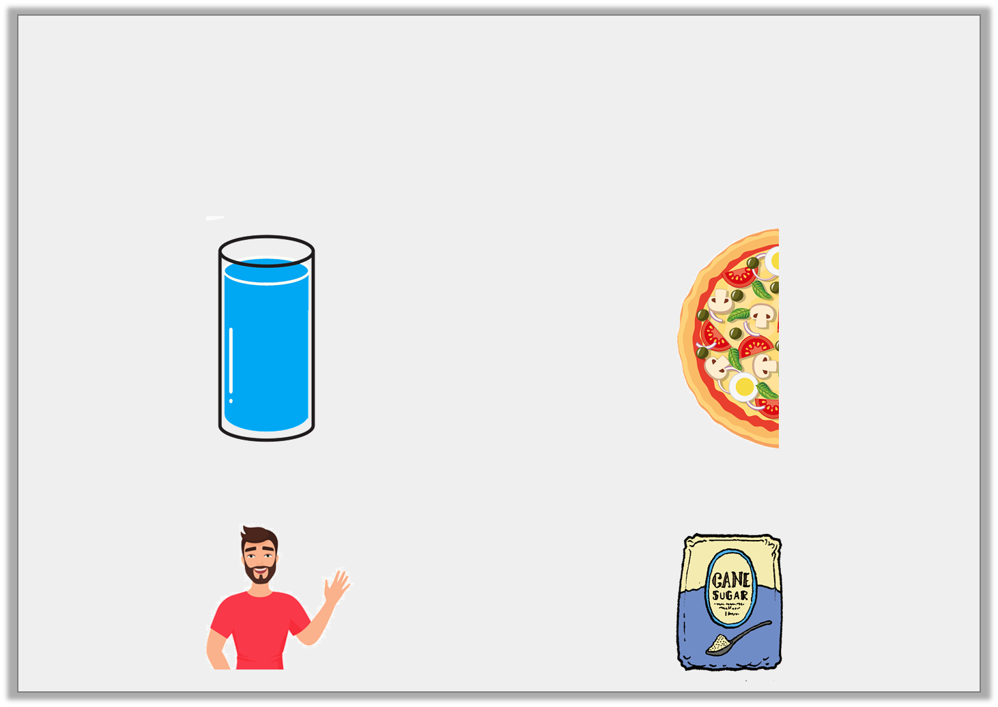
Varied Fluency 3
Add the missing vowels to the words below.
w _ t _ r | h _ l f
f _ t h _ r | s _ g _ r
© Classroom Secrets Limited 2018

Slide 12
Varied Fluency 3
Add the missing vowels to the words below.
w a t e r | h a l f
f a t h e r | s u g a r
© Classroom Secrets Limited 2018

Slide 13
Varied Fluency 4
Circle the words that use the long ‘a’ vowel sound in the sentences below.
Please be gentle and don’t break the glass.
I am going to play football again on Sunday.
My dog loves great, big hugs.
© Classroom Secrets Limited 2018

Slide 14
Varied Fluency 4
Circle the words that use the long ‘a’ vowel sound in the sentences below.
Please be gentle and don’t break the glass.
I am going to play football again on Sunday.
My dog loves great, big hugs.
© Classroom Secrets Limited 2018

Slide 15

Application 1
Write an 8-letter word with 3 vowels to match the picture below.
Underline the vowels.
c _ _ _ _ _ _ _
© Classroom Secrets Limited 2018

Slide 16
Application 1
Write an 8-letter word with 3 vowels to match the picture below.
Underline the vowels.
c a l e n d a r
© Classroom Secrets Limited 2018

Slide 17
Application 2
Sergei is thinking of a word.
The word has 6 letters including the vowels ‘e’ and ‘i’.
Write 3 words that Sergei could be thinking of.
1. ________________________________
2. ________________________________
3. ________________________________
© Classroom Secrets Limited 2018

Slide 18
Application 2
Sergei is thinking of a word.
The word has 6 letters including the vowels ‘e’ and ‘i’.
Write 3 words that Sergei could be thinking of.
Various answers, for example:
1. ________________________________
2. ________________________________
3. ________________________________
auntie
advice
pieces
© Classroom Secrets Limited 2018

Slide 19
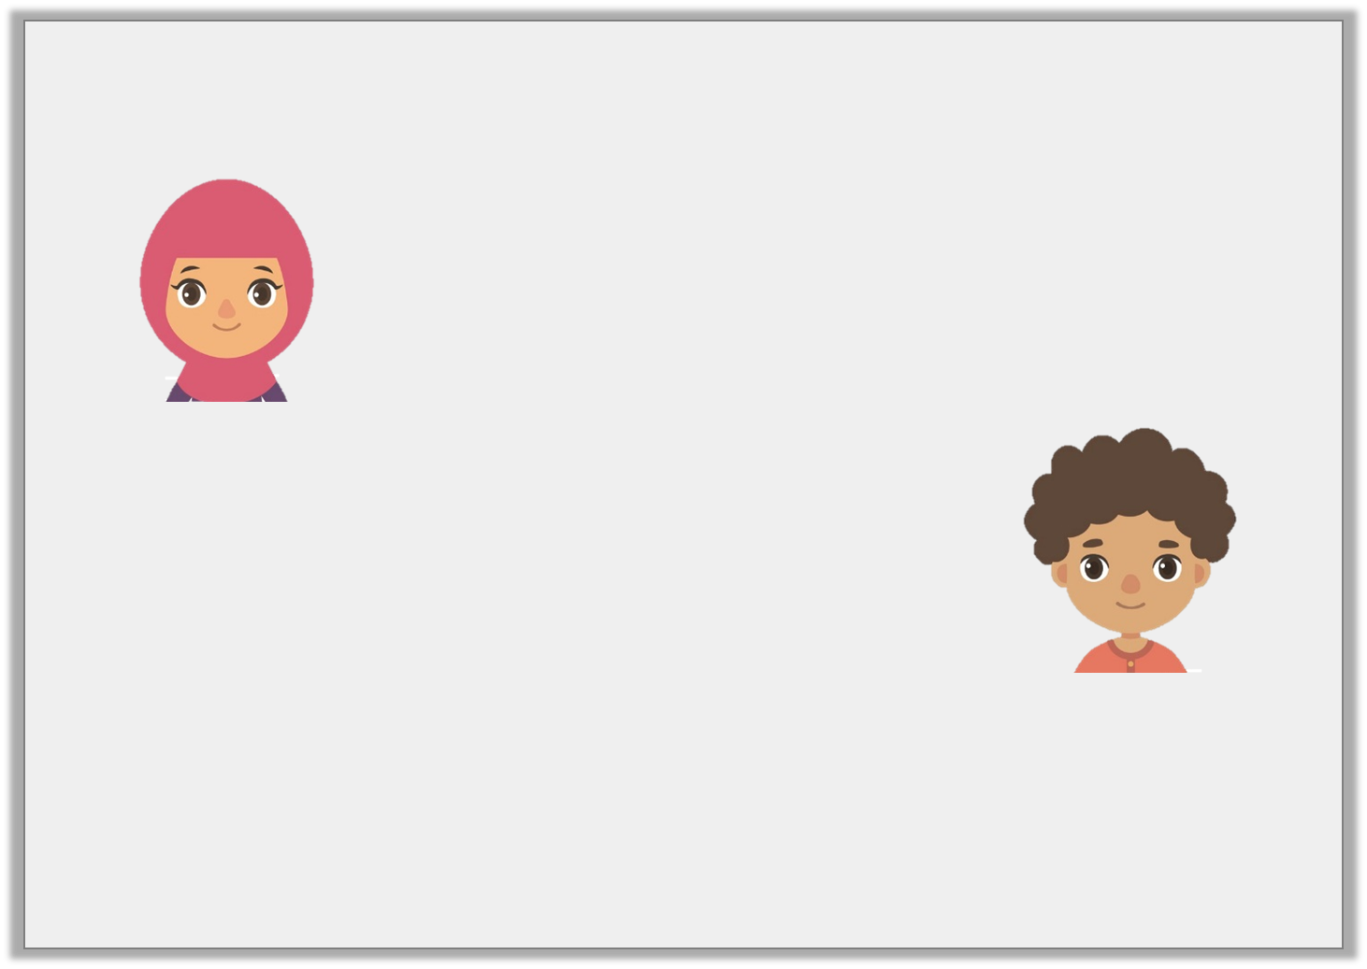
Reasoning 1
Kiran says,
Callum says,
Who is correct? Explain why.
The word ‘froze’ has a short vowel sound.
The word ‘froze’ has a long vowel sound.
© Classroom Secrets Limited 2018

Slide 20
Reasoning 1
Kiran says,
Callum says,
Who is correct? Explain why.
Callum is correct because…
The word ‘froze’ has a short vowel sound.
The word ‘froze’ has a long vowel sound.
© Classroom Secrets Limited 2018

Slide 21
Reasoning 1
Kiran says,
Callum says,
Who is correct? Explain why.
Callum is correct because the word ‘froze’ has the split diagraph o_e which makes a long ‘o’ sound.
The word ‘froze’ has a short vowel sound.
The word ‘froze’ has a long vowel sound.
© Classroom Secrets Limited 2018

