Slide 1
Summer Term 2 – Week 8
Well, this is it! The final week of our school year. It has truly been a special year and certainly one we will never forget. We will all go down in history as the classes that got through lockdown! (I do hope that it isn’t something that needs to be repeated.)
I’d like to say the most heartfelt of thanks to every single one of you (parents and children) for adapting to this unprecedented way of working and embracing it with resilience. Thank you for your messages, videos, posts, photographs and comments; they've made this whole bizarre experience so much easier.
For the final week in school, we would usually reflect upon the year and have some celebrations. We usually have an awards ceremony and a few games of water rounders. I’m incredibly sad that we are missing out on this but even more sad as we say goodbye to some members of our class, without getting to do so in person. This year we are losing 3 very lovely children and families from our St Jo’s family:
Finley, Elijah and Cormac
I only wish there were a fitting way to send you all off in style with the cards and well wishes that you deserve from your friends. We wish you every happiness in your new schools and know that you will achieve great things!
There is no White Rose this week as they have finished for the summer, but I will be sharing some home learning books from them on our whole school Dojo page. I’ve put lots of activities in the Dropbox for you and an other faiths project. There’s also some checklists for moving to the next year group too.
Enjoy the final days of term and hopefully I will see lots of you at our final Zoom at 10:40 on Wednesday!
Mrs B

Slide 2
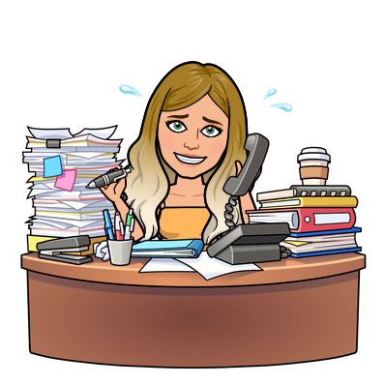
Daily tasks
Times Tables
Maths online
Morning Challenge
BBC
Spelling Frame
English Y5 Y4
Reading

Slide 3
Click on the day you need to see the Morning challenge answers.

Slide 4
Monday
Tuesday
Wed
Thursday
Friday
Back
To
Menu
Week 1
Click on the book covers each day to go to the video of me reading!
(or listen to them together if you can’t wait)
Week 2
Week 3
Week 4
Click onto the next page for our new book
Week 5

Slide 5
Monday
Tuesday
Wed
Thursday
Friday
Back
To
Menu
Week 5
Click on the book covers each day to go to the video of me reading!
(or listen to them together if you can’t wait)
Week 6
Week 7
Week 8
To be continued

Slide 6
Extra Maths
Gareth Metcalffe maths – daily – 9am
Maths with Carol Vorderman 10am
Daily
Whiterose 10am
Daily
I see maths Daily
Sumdog
Prodigy
Mathletics
Mathsframe
Homeschool History Channel 9:30am
Draw a story 10am M/Tu/W
Music with Myleen Klass M/F 10am
Science daily 10am
Minilingos Spanish 10:30 Tuesdays
Live Art 11am Monday
Body percussion Daily 11am
Hobbycraft craft club daily 11am
Science with Maddie Daily 11am
Techniquest Science daily 12pm
Sign language Daily 1pm
History Wednesday 1pm
Art hub Tuesday 2pm
Bake off 2pm Wed
Life lessons Daily 2pm
Extra English
Authorfy daily 9am
Pie Corbett English daily 9:30
Sentence work daily 9:45
Lit fest daily 10:30
Daily tutor
Back
To
Menu

