Slide 1
Summer Term 2 – Week 7
Welcome to innovate week! This week is all about using your topic knowledge and putting it into action. Instead of your usual topics there will be tasks to follow, which make up your secret mission!
(You can still access your maths, morning challenge, class novel, Oak Academy and Bitesize in the normal way. I’ve added 2 year 4 grammar skills sheets as there are no more Y5 ones in the series)
You should be receiving an email to tell you your new class for September and you will be receiving a zoom chat invite from your new teacher too so that you can have a little chat with them this week or next week.
I can’t believe it’s almost the summer holidays! What a very strange school year we have had! A massive well done to everyone for coping through this unusual way of schooling alongside everything else that has been going on. You’re all amazing! Thank you for the infinite support! This will certainly be a school year that none of us will ever forget!
Our Zoom chat is at 11:00 AM on Wednesday, (this repeats weekly) This week we will be having a kahoot quiz. Children will be given a quiz code and will need to have the kahoot site open in another tab on their device https://us04web.zoom.us/j/73617786652?pwd=emxNZEp2VkZPNUV2ZWJHZTNMbGN0UT09
Meeting ID: 736 1778 6652
Password: StFrancis
Dropbox Link: https://www.dropbox.com/sh/71oydxpqvuai1i7/AACtriqx_G0vgu2HrQX7kN-za?dl=0

Slide 2
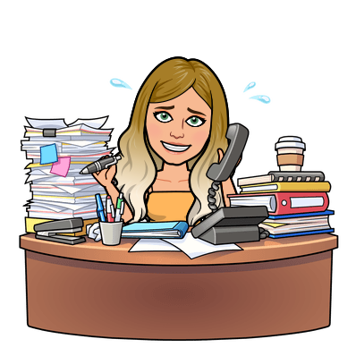










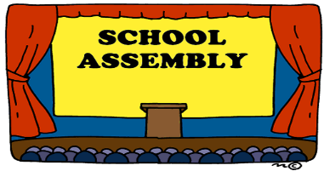
Daily tasks
Times Tables
Maths online
Morning Challenge
BBC
Spelling Frame
English Y5 Y4
Reading

Slide 3
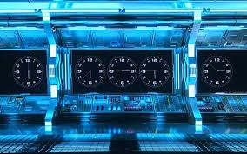

Mission: Beast Creator
A super strong aphid is destroying crops across the UK. United Nation scientists have decided to use selective breeding to create a super mini-beast that can exterminate these greedy aphids. As a member of the selective breeding team, you must create a super beast in order to control or exterminate this outbreak.

Slide 4
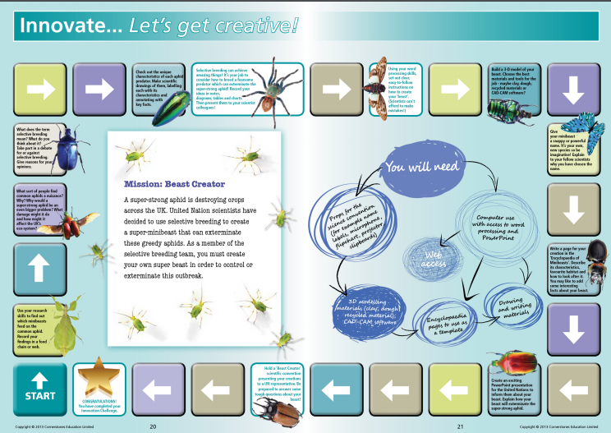
Download your innovate board from dropbox to work through your mission!

Slide 5
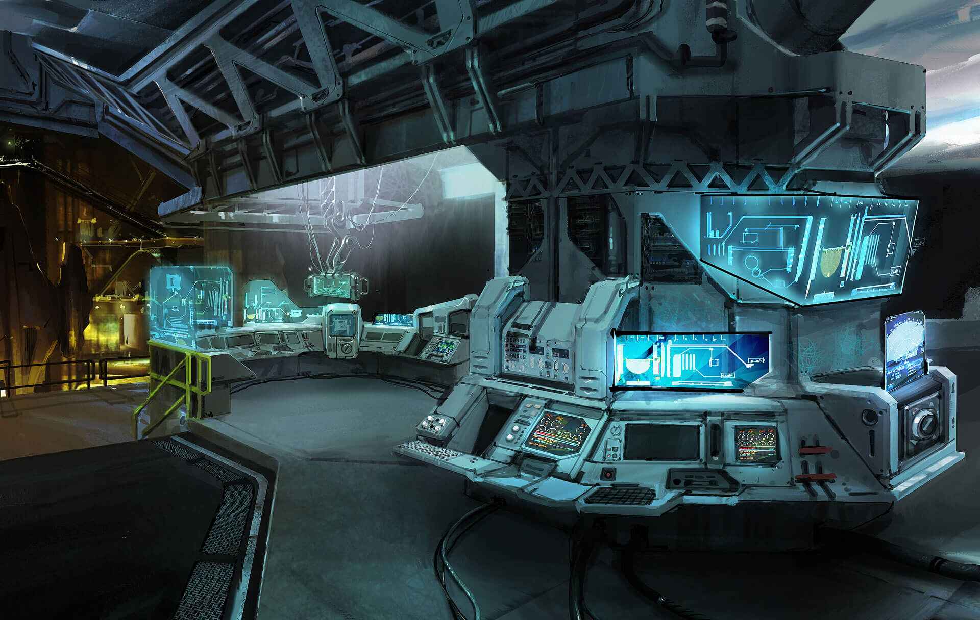
Task 1:
Use your research skills to find out which mini-beasts feed on the common aphid. Record your findings in a food chain or web to ensure that you know which creature DNA would be useful in your work.
Task 2:
Do some research into which sort of people find common aphids a nuisance? Why? Why would a super-strong aphid be an even bigger problem? What damage might it do and how might it affect the UK’s ecosystems? Keep a log of these people, they will be you allies.
Task 3:
Find out what the term selective breeding means? What examples are there already in existence? What are the positives? What are the negatives? What do you think about it? Prepare a debate speech for or against selective breeding. Remember to give reasons for your opinions.

Slide 6
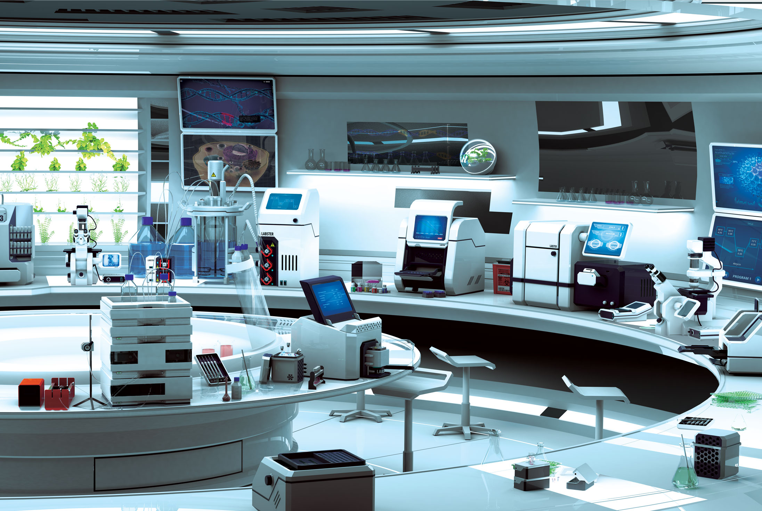
Task 4:
Check out the unique characteristics of each aphid predator. Do they have special features that aid them to be an effective predator? Make scientific drawings of them, labelling each with its characteristics and annotating with key facts.
Task 5:
Selective breeding can achieve amazing things! It’s now your job to consider how to breed a fearsome predator which can exterminate the super-strong aphid! Record your ideas with notes, diagrams, tables and charts. Then present your super-predator designs!
Task 6:
Using your word processing skills, set out clear, easy-to-follow instructions on how to create your ‘beast’. Scientists can’t afford to make mistakes so use lots of imperative verbs to guide them in making your creation.

Slide 7
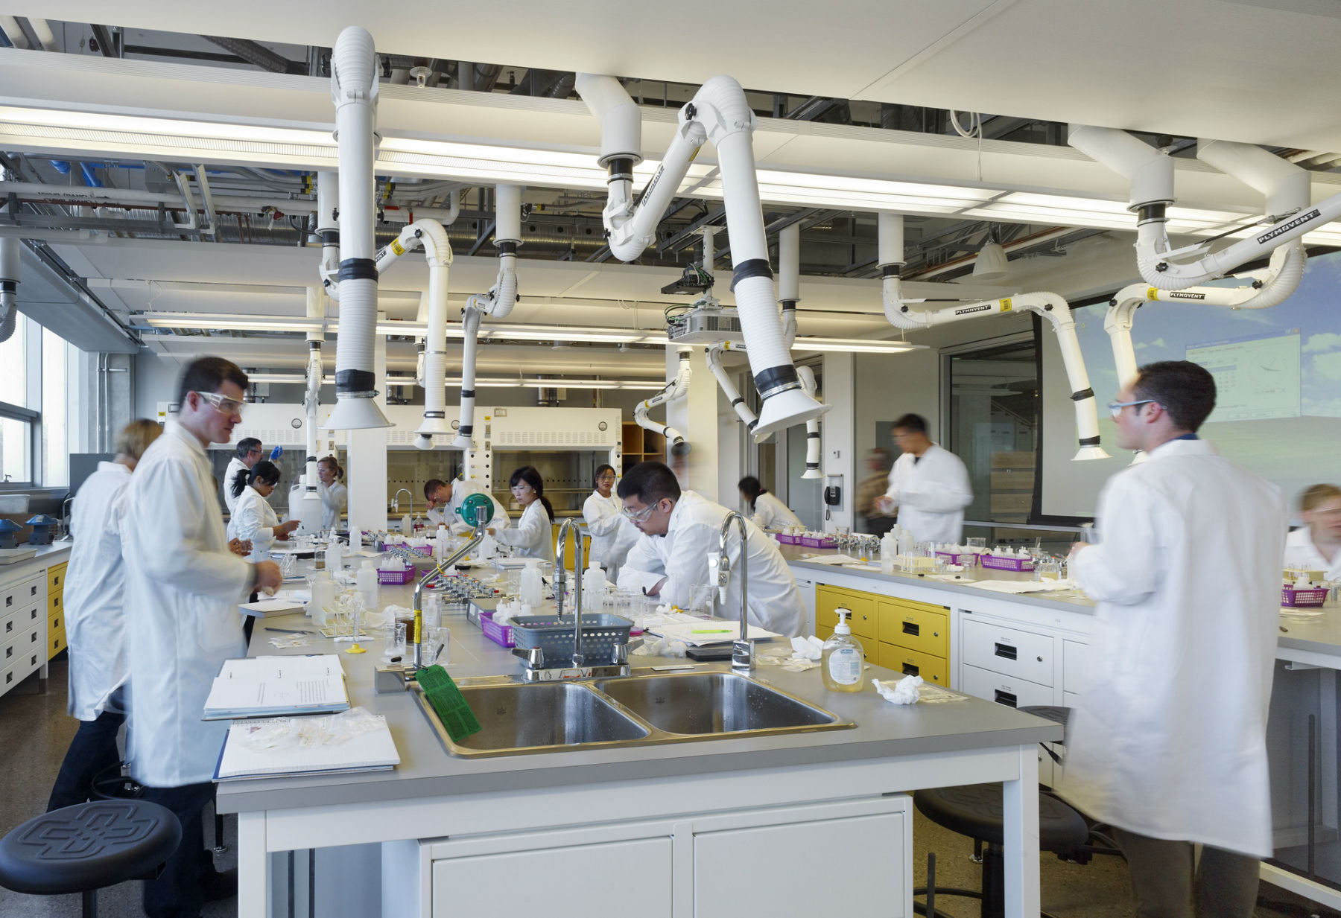
Task 7:
Build a 3-D model of your beast. Choose the best materials and tools for the job – maybe clay, dough, recycled materials or a virtual model using software? Tinker CAD is a great online piece of modelling software that you can use for free. Take a photo to show your team.
Task 8:
Give your mini-beast a snappy or powerful name. It’s a new species so be imaginative! Explain to your fellow scientists why you have chosen the name.
Task 9:
Write an information page for your creation in the ‘Encyclopaedia of Mini-beasts’. Describe its characteristics, favourite habitat and how to look after it. You may like to add some interesting facts about your beast. Remember to include an illustration or picture of your beast.

Slide 8
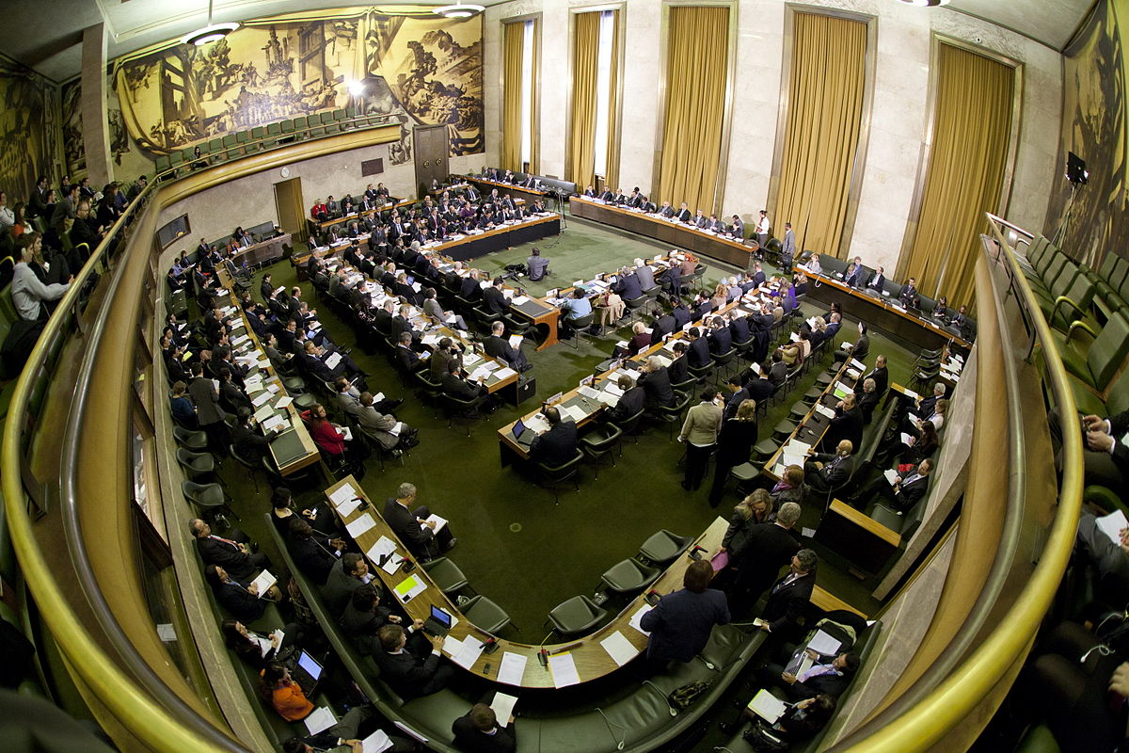
Task 10:
Create an exciting presentation for the United Nations to inform them about your beast. Explain how your beast will exterminate the super-strong aphid and prevent global famine!
Task 11:
Hold a ‘Beast Creator’ scientific convention presenting your creations to a UN representative. Be prepared to answer some tough questions about your beast!

Slide 9
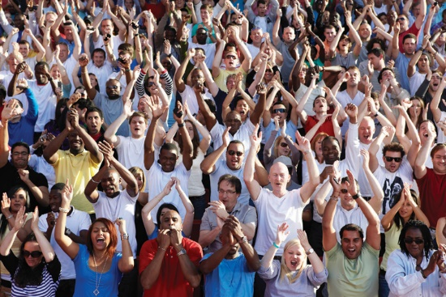
CONGRATULATIONS!
You have completed your Challenge and stopped the invasion of the
super-aphids!
The world’s farmers & wider population thank you!

Slide 10





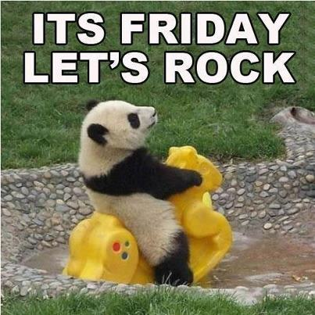

Click on the day you need to see the Morning challenge answers.

Slide 11
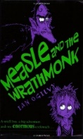









Monday
Tuesday
Wed
Thursday
Friday
Back
To
Menu
Week 1
Click on the book covers each day to go to the video of me reading!
(or listen to them together if you can’t wait)
Week 2
Week 3
Week 4
Click onto the next page for our new book
Week 5

Slide 12

Monday
Tuesday
Wed
Thursday
Friday
Back
To
Menu
Week 5
Click on the book covers each day to go to the video of me reading!
(or listen to them together if you can’t wait)
Week 6
Week 7
Week 8

Slide 13
Extra Maths
Gareth Metcalffe maths – daily – 9am
Maths with Carol Vorderman 10am
Daily
Whiterose 10am
Daily
I see maths Daily
Sumdog
Prodigy
Mathletics
Mathsframe
Homeschool History Channel 9:30am
Draw a story 10am M/Tu/W
Music with Myleen Klass M/F 10am
Science daily 10am
Minilingos Spanish 10:30 Tuesdays
Live Art 11am Monday
Body percussion Daily 11am
Hobbycraft craft club daily 11am
Science with Maddie Daily 11am
Techniquest Science daily 12pm
Sign language Daily 1pm
History Wednesday 1pm
Art hub Tuesday 2pm
Bake off 2pm Wed
Life lessons Daily 2pm
Extra English
Authorfy daily 9am
Pie Corbett English daily 9:30
Sentence work daily 9:45
Lit fest daily 10:30
Daily tutor
Back
To
Menu

