Slide 1


Summer Term 2 – Week 6
Hello St Francis! It’s sports week. We’ve sadly not had a sports day, so I’ve put my house team colours on and I’m all ready for a week of sports activities! Who’s ready?
We will even have a sport themed zoom chat on Wednesday!
Like all good sportsmen know, our attitude is the most important thing! Playing fair, being gracious in victory as well as defeat. Let’s be really positive and see what we can achieve when we try our best!
Have a super week everyone!
Our Zoom chat is at 11:00 AM on Wednesday, (this repeats weekly) https://us04web.zoom.us/j/73617786652?pwd=emxNZEp2VkZPNUV2ZWJHZTNMbGN0UT09
Meeting ID: 736 1778 6652
Password: StFrancis
Dropbox Link: https://www.dropbox.com/sh/s1wo6f7q8jjwi0z/AABECGgS8ZvjoGlqXjoGo5Iia?dl=0

Slide 2
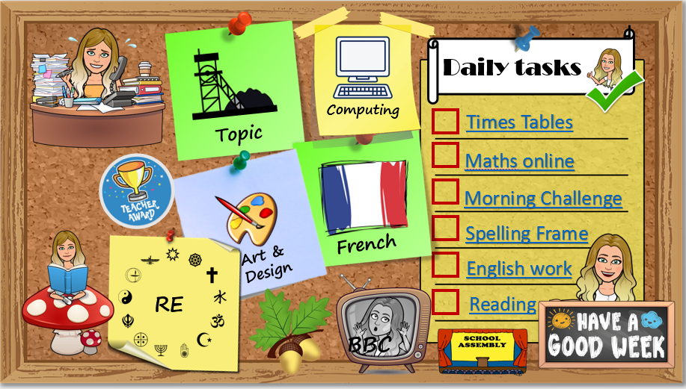
How to use…
Click on the subject icons to visit the slide with more information.
I would like you to choose from the subjects if you can.
Go to Mrs B’s video walkthroughs
I would like you to do these things daily.
Click on the sticker to visit the slide with extra tasks.
Go to Mrs B’s reading page.
Click on the Oak icon to visit The National Oak Academy website.
Click on the TV icon to visit BBC live lessons.
Click on the text to visit the website of your task.
Click the icon to visit the assembly menu.

Slide 3





















Daily tasks
Computing
Times Tables
Topic
Maths online
Morning Challenge
Spelling Frame
French
Art & Design
English Y5 Y4
RE
Reading
BBC

Slide 4

French
https://www.bbc.co.uk/bitesize/subjects/z39d7ty
Of course, with it being sports week, we will have a look at French sports!
https://www.youtube.com/watch?v=WLq8VJ2EHzk
Check the Dropbox link for resources to support this learning.
Back
To
Menu

Slide 5


Welcome to the first ever, St Francis, Virtual Sports Week! I hope that we never have to repeat this and that we can do it all in real life very soon!
I have set you some sporting challenges in the dropbox folder (You don’t need to print them, just have a read through, pick the challenges you will take, give it a go and count up your points.) Let’s see who will make it onto our podium! Don’t worry if you haven’t got PE equipment at home, there are lots of variations to help you.
Most of all, have fun keeping active!
Back
To
Menu

Slide 6
Children’s liturgy for this week: https://www.youtube.com/watch?v=SSxYrOneN00
I would love to see any of the children you make!
RE
Understanding the mass (Part 2) Last week, we began to look at The Catholic Mass. We will continue with that learning this week and you will be able to add more information to your mass guide. In order to receive Holy Communion, those who have taken their first Holy Communion will stand by the altar rail. They will first receive the host (bread) from the Priest or a ‘Eucharist Minister’. Then they will move to the person holding the chalice (cup) and take a sip of precious blood. Catholics believe that this is the body and blood of Jesus, whereas Christians of The Church of England believe that it is a representation of Christ. During the service, hymns and even prayers may be sung. In the Catholic church, it is believed that worship of God and prayers are all performed along with the saints. Mary, Jesus’ mother, is one of the most important saints with whom they pray. Catholics believe that Mary speaks on their behalf to God. In their personal prayers, some people have a set of beads called the Rosary of the Virgin Mary, and they use them to say special prayers. Here is a video which explains mass and the things you may hear or see during Mass. http://request.org.uk/wp-content/uploads/2013/06/catholic_mass_avi.mp4 Continue to design a leaflet that explains mass to a younger child in KS1.
Back
To
Menu

Slide 7

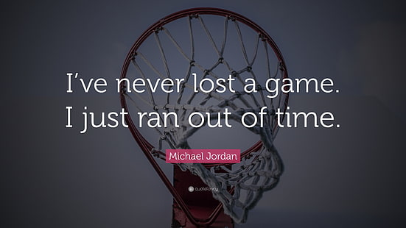

Sports art:
There are two art activities that I have for you this week. (You could do lots more of your own)
Option 1: Positivity – There are so many inspirational quotes to motivate people. Without the fancy text and images, they aren’t as powerful. Find a quote that inspires you. Try using a fancy font and adding colour and pictures to it to emphasise the meaning.
Option 2: Action
Watch this lady explain how to draw comic strip characters and bring action to them: https://www.youtube.com/watch?v=DkM6FgbQIGs
Can you create some sports pictures? How can you show speed and movement in your character? Also this video shows you how to build around a stick figure to create action figures: https://www.youtube.com/watch?v=1jA-57wtFWk
Art & Design
Back
To
Menu

Slide 8

Science
What you'll need:
A pen or pencil, Paper to write your findings on,An empty tube (an old kitchen roll tube is good),A cup of water, A small ball (or something soft you can throw)
Instructions:
Write ‘left’ or ‘right’ next to each task depending on what side you used/favoured.
When you’ve finished all the challenges review your results and make your own conclusions about which is your dominant eye, hand and foot.
Which eye do you use to wink? Which eye do you use to look through the empty tube?
Extend your arms in front of your body. Make a triangle shape using your fore fingers and thumbs. Bring your hands together, making the triangle smaller (about the size of a coin is good). Find a small object in the room and focus on it through the hole in your hands (using both eyes). Try closing just your left eye and then just your right, if your view of the object changed when you closed your left eye mark down ‘left’, if it changed when you closed your right eye mark down ‘right’.
Hand/Arm tests:
Which hand do you use to write?
Pick up the cup of water, which hand did you use?
Throw the ball, which arm did you use?
Foot/Leg tests:
Run forward and jump off one leg, which did you jump off?
Drop the ball on the ground and kick it, which foot did you use?
Continued on the next page…
Topic
Back
To
Menu

Slide 9
Science Continued…
Results
So what side do you favour? Are you left handed or right handed? Left footed or right footed? Is your right eye dominant or is it your left?
Around 90% of the world’s population is right handed. Why most people favour the right side is not completely understood by scientists. Some think that the reason is related to which side of your brain you use for language. The right side of your body is controlled by the left side of your brain, and in around 90% of people the left side of the brain also controls language.
Around 80% of people are right footed and 70% favour their right eye. These percentages are lower than those who are right handed and this could be because your body has more freedom of choice in choosing its favoured foot and eye than that of its favoured hand. In other words you are more likely to be trained to use your right hand than your right foot and even more so than your right eye.
It’s not strange to find people who favour the opposite hand and foot (e.g. left hand and right foot), and some people are lucky enough to be ambidextrous, meaning they can use their left and right sides with equal skill.
Extra: Are you more likely to be left handed if one of your parents is left handed? Test your family and compare your results. What are some of the possible disadvantages for left handed people? (Tools, writing materials etc) Do left handed people have an advantage in sports?
Interesting fact: In 2009, In America, only 7% of the players in the NBA (Basketball) were left handed while in 2008 around 26% of MLB (Baseball) pitchers were left handed.
Is it better to be left handed in some sports than others? What do you think?
Topic
Back
To
Menu

Slide 10

Click the icon
and see what
has been
set for you.
There are weekly tasks
that you can access too.
Computing
Back
To
Menu
It is important that we learn to type quickly. It prepares us for life outside of school in the digital world.
https://www.bbc.co.uk/bitesize/topics/zf2f9j6/articles/z3c6tfr

Slide 11





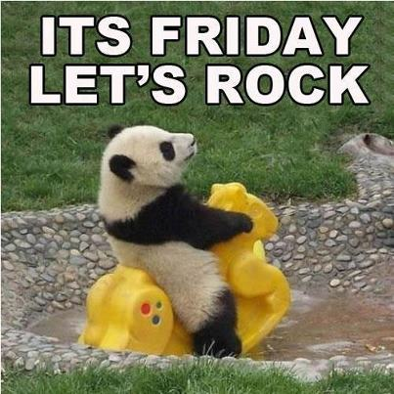
Click on the day you need to see the Morning challenge answers.

Slide 12










Monday
Tuesday
Wed
Thursday
Friday
Back
To
Menu
Week 1
Click on the book covers each day to go to the video of me reading!
(or listen to them together if you can’t wait)
Week 2
Week 3
Week 4
Click onto the next page for our new book
Week 5

Slide 13

Monday
Tuesday
Wed
Thursday
Friday
Back
To
Menu
Week 5
Click on the book covers each day to go to the video of me reading!
(or listen to them together if you can’t wait)
Week 6
Week 7
Week 8

Slide 14
Extra Maths
Gareth Metcalffe maths – daily – 9am
Maths with Carol Vorderman 10am
Daily
Whiterose 10am
Daily
I see maths Daily
Sumdog
Prodigy
Mathletics
Mathsframe
Homeschool History Channel 9:30am
Draw a story 10am M/Tu/W
Music with Myleen Klass M/F 10am
Science daily 10am
Minilingos Spanish 10:30 Tuesdays
Live Art 11am Monday
Body percussion Daily 11am
Hobbycraft craft club daily 11am
Science with Maddie Daily 11am
Techniquest Science daily 12pm
Sign language Daily 1pm
History Wednesday 1pm
Art hub Tuesday 2pm
Bake off 2pm Wed
Life lessons Daily 2pm
Extra English
Authorfy daily 9am
Pie Corbett English daily 9:30
Sentence work daily 9:45
Lit fest daily 10:30
Daily tutor
Back
To
Menu

