Slide 1

Reincarnation
Learning Outcome: To be able to explain the Hindu belief in reincarnation
STM – team workers
“If you knew you would be born again do you think it would encourage people to behave badly?”
Give two reasons for your point of view.

Slide 2
What is reincarnation?
Discuss in pairs.
Soul = atman

Slide 3
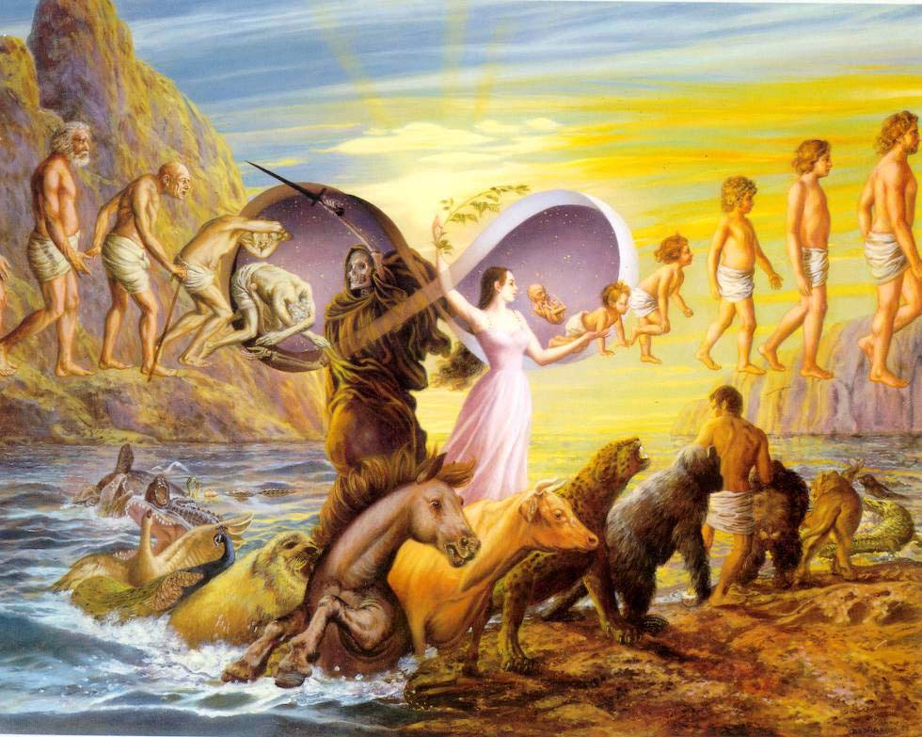

Slide 4

Activity to enable students to understand the law of samsara
Brahman
Side nearest door to do the good actions which will allow you to move up samsara
Side nearest window to do the bad actions which will send you back down samsara
Samsara – the repeated cycle of birth and death

Slide 5
Hindus believe you can be reborn as a human being many times
Brahman
Soul = atman
Reincarnation – the belief that your soul moves onto another being when you die

Slide 6
The four ashramas (stages of life)
name of stage of life
what they are expected to do
how can they move up in the next life
Why would they want to move up a stage
Brahman

Slide 7
The four ashramas (stages of life)
The 1st/2nd/3rd/4th stage of life is called................
In this stage they are expected to…………………………
This is because……………………………………………..
They can move to the next life by……………………………
Hindu’s would want to move up a stage because……………
Brahman

Slide 8
Activity to enable students to make links between behaviour and rebirth
1. If you thought you had many human lives, do you think it would make this life less important or more important? Why?
2. Why do you think not all Hindu’s follow each stage of human life?
3. Hindu’s believe in the 3rd and 4th stage you are most likely to achieve Moksha, why do you think this is?
Moksha – the release of your soul from being reborn
Are they correct (use your info. sheet), what could they add to their answer? What was good about their answer?

Slide 9
Activity to check students beliefs about reincarnation
True or False? Can you give me extra detail?
The worst life you can live is with Brahman
The soul of a bug is different to the soul of a human
The aim of samsara is to achieve bad karma
You only live one human life before reaching moksha

Slide 10




Self Managers
Take responsibility for yourself.
Team Workers
To collaborate and work with others
Creative Thinkers
Use your imagination
Independent Enquirers
Be able to work by
yourself
Reflective Learners
Monitor your own performance
Effective Participants
Be involved in discussions

