Slide 1
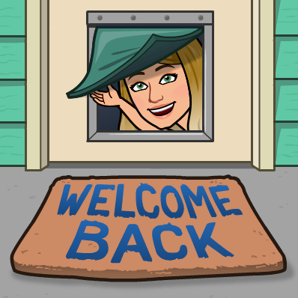
Summer Term 2 – Week 1
Hello everyone! I hope you had a wonderful half term and enjoyed the amazing weather that we’ve been having. I’d love to hear what you’ve been up to.
This half term our topic is Beast Creator. We’ll explore a range of minibeasts and small creatures. Taking photographs, making notes and listening carefully to expert explanations will help us to understand how minibeasts move, what they eat and where they live. Using what we’ve learned, we’ll write an interesting minibeast report. In science, we’ll learn how to categorise minibeasts and investigate woodlice habitats. We’ll make detailed drawings of our minibeasts and present data about them. Using wood, stones, garden canes and other natural materials, you can create ‘minibeast hotels’ and write adverts to attract minibeasts to stay in them. We’ll create a comic about deadly creatures and use interesting vocabulary to write minibeast poems. At the end of the project, you can write fantasy stories about a minibeast’s adventures, make a fantastic fact file and create a 3-D minibeast using a range of materials. Can you start your project by going on a minibeast hunt? Take plenty of photos and use an app or spotting guide to identify different creatures. What do you find? Where does it like to live? I’ve added a huge library of topic books to your Get Epic reading lists too, there/s some really interesting stuff in there.
Maths will continue on White Rose Hub and English via The Oak academy. A heap of resources for this term can be found in the Dropbox link here: https://www.dropbox.com/sh/dfm6gywfe7x3nm6/AAAmb7XvffC_Nt-vj-k_mio7a?dl=0
Looking forward to some amazing work this term!

Slide 2
How to use…
Click on the subject icons to visit the slide with more information.
I would like you to choose from the subjects if you can.
Go to Mrs B’s video walkthroughs
I would like you to do these things daily.
Click on the sticker to visit the slide with extra tasks.
Go to Mrs B’s reading page.
Click on the Oak icon to visit The National Oak Academy website.
Click on the TV icon to visit BBC live lessons.
Click on the text to visit the website of your task.
Click the icon to visit the assembly menu.

Slide 3
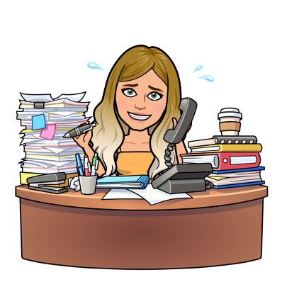
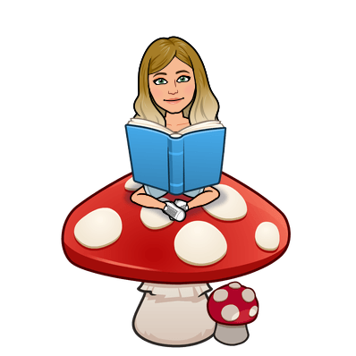
Daily tasks
Computing
Times Tables
Topic
Maths online
Morning Challenge
Spelling Frame
French
Art & Design
English work
RE
Reading
BBC

Slide 4
French
https://www.bbc.co.uk/bitesize/subjects/z39d7ty
https://www.bbc.co.uk/teach/supermovers/ks1--ks2-mfl-french-greetings-with-ben-shires/zdpdvk7
Back
To
Menu

Slide 5
Jumpstart Johnny Daily 9am Kimberly Wyatt Dance Wed/Fri 10am Strictly dance 10:30 daily Dance movement 10:30 daily Lifesaving 11am Fridays Shake up 1:30 weekdays Footy fitness 3:30 daily KS2 Ballet 4pm daily Joe Wicks PE daily 9am GoNoodle on demand
Remember to stay active!
Back
To
Menu

Slide 6
Children’s liturgy for this week:
https://www.youtube.com/watch?v=bGZC24FNGR0
RE
Back
To
Menu
Watch a cartoon version of the story of the Coming of the Holy Spirit Acts Ch2. https://youtu.be/KwJJJoSGw84 Remember that this account was written by Luke who also wrote one of the Gospels. He is recounting what happened to the followers of Jesus after Jesus rose from the dead. Although this is a historical account, Luke wasn’t just giving the facts, he was trying to say how people felt and how they felt this event changed them. No one can really describe what happens when the Spirit comes, so Luke uses symbols and similes to try and describe the Spirit and its effects. Remember they were there to celebrate the Jewish feast of Pentecost or Shavu’ot. After the event Christians took over the name. Read St Paul’s letter to the Colossians Ch 3: 12 – 17 Your New Life With Each Other https://www.liturgyoffice.org.uk/Resources/Marriage/Reflections/OCM-Lectionary-N9-R.pdf Discuss the qualities needed to witness Jesus. Which are the most important? Why? Can you write a letter advertising for a witness of The Holy Spirit. Specify the qualities that the person must have.

Slide 7
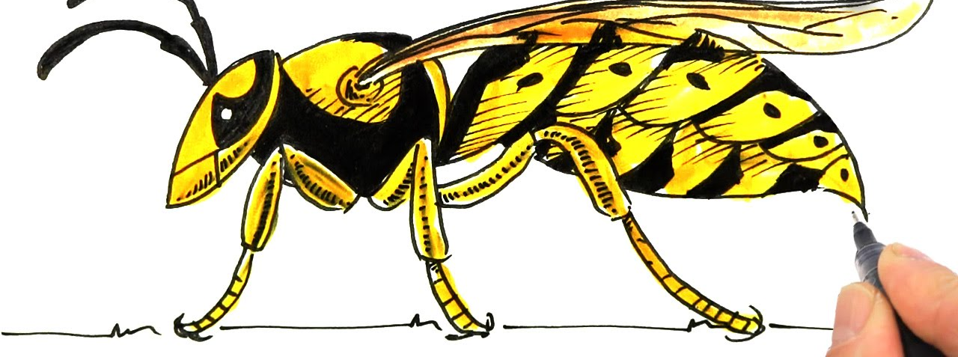
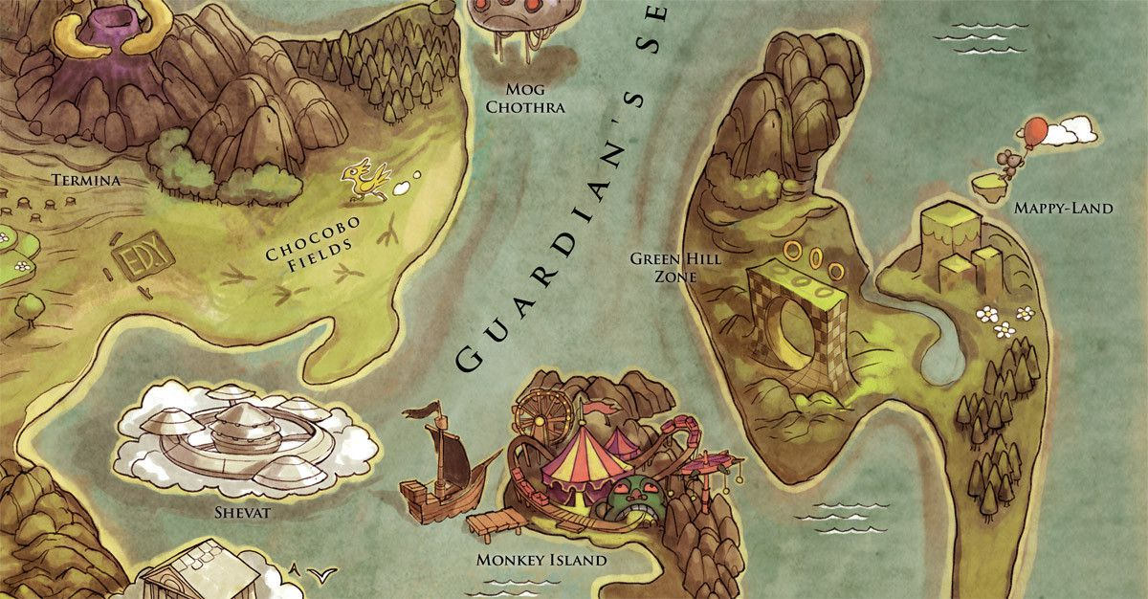
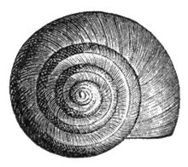
Make a map of your minibeast hunt. Can you add a key to identify where certain creatures were found?
You could make a fairytale map where talking insects live and label the different towns. This could be a great stimulus for some free writing.
Create an observational drawing of a minibeast that you find. Snail shells are always interesting to draw.
Art & Design
Back
To
Menu

Slide 8
Analyse a range of non-fiction texts with a minibeast theme (Get Epic has LOADS! And I’ve added one to Dropbox about the Hercules beetle) , identify specific conventions (features) of the genre by making notes or screen shot a page and annotate the features.
Collect technical and ‘wow’ words related to the theme and start building a topic-specific word bank. Highlight any unfamiliar words and look up their meaning in a dictionary.
How many impressive words can you send to me this week?
Choose a favourite minibeast to gather information about, draft notes for a non-chronological report. Think about your target audience – perhaps a younger reader, a scientist or a visitor. What would they want to know?
*Your final report will need to include a title, subtitle, a general opening statement about the topic, impressive vocabulary, varied sentence openers, paragraphs, conjunctions, an impersonal style (third person), pictures and diagrams, labels and captions, facts (not opinions), subject-specific vocabulary and a concluding statement, so plan carefully to make sure that you have all of the information you need.
Learn how we group and classify minibeasts http://ypte.org.uk/factsheets/minibeasts/grouping-invertebrates
Topic
Back
To
Menu

Slide 9
Click the icon
and see what
has been
set for you.
There are weekly tasks
that you can access too.
Computing
Back
To
Menu
It is important that we learn to type quickly. It prepares us for life outside of school in the digital world.
https://www.bbc.co.uk/bitesize/topics/zf2f9j6/articles/z3c6tfr

Slide 10
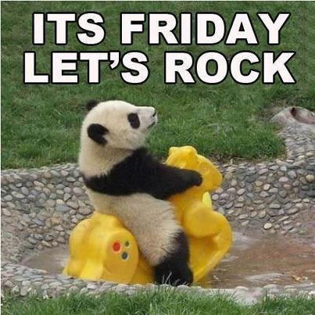
Click on the day you need to see the Morning challenge answers.

Slide 11
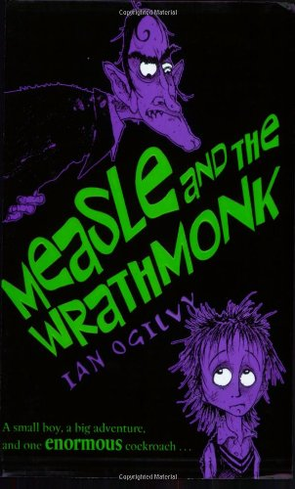
Back
To
Menu
Click on the book covers each day to go to the video of me reading!
(or listen to them together if you can’t wait)
Log in and
complete your
comprehension tasks
Read for pleasure
Monday
Tuesday
Wednesday
Thursday
Friday

Slide 12
Extra Maths
Gareth Metcalffe maths – daily – 9am
Maths with Carol Vorderman 10am
Daily
Whiterose 10am
Daily
I see maths Daily
Sumdog
Prodigy
Mathletics
Mathsframe
Homeschool History Channel 9:30am
Draw a story 10am M/Tu/W
Music with Myleen Klass M/F 10am
Science daily 10am
Minilingos Spanish 10:30 Tuesdays
Live Art 11am Monday
Body percussion Daily 11am
Hobbycraft craft club daily 11am
Science with Maddie Daily 11am
Techniquest Science daily 12pm
Sign language Daily 1pm
History Wednesday 1pm
Art hub Tuesday 2pm
Bake off 2pm Wed
Life lessons Daily 2pm
Extra English
Authorfy daily 9am
Pie Corbett English daily 9:30
Sentence work daily 9:45
Lit fest daily 10:30
Daily tutor
Back
To
Menu

