Slide 1
Summer Term 2 – Week 5
What a beautiful week it was last week. I really enjoyed catching up with some pupils on our Zoom chat and speaking to some Y4 parents about classes for next year. I can’t believe that we’re discussing next year already. It makes me sad that we’ve had so much of our year together stolen by this virus, but I will still be around next year if you need anything or just want a chat!
The weather forecast this week looks wet. A perfect opportunity to see which mini beasts appear to like a wet habitat and which ones hide away. Try making your own habitat experiment in the science section of the PowerPoint.
Our Zoom chat is at 11:00 AM on Wednesday, (this repeats weekly) https://us04web.zoom.us/j/73617786652?pwd=emxNZEp2VkZPNUV2ZWJHZTNMbGN0UT09
Meeting ID: 736 1778 6652
Password: StFrancis
All but a couple of the buddy letters are now in. Please could I have any outstanding ones this week so that I can get them all sent at the same time.
Here’s the Dropbox link for this week: https://www.dropbox.com/sh/ralxvi5utm0tqsb/AADR6QklBGLHB5B_pWlVh6zNa?dl=0
Have a great week everyone!

Slide 2
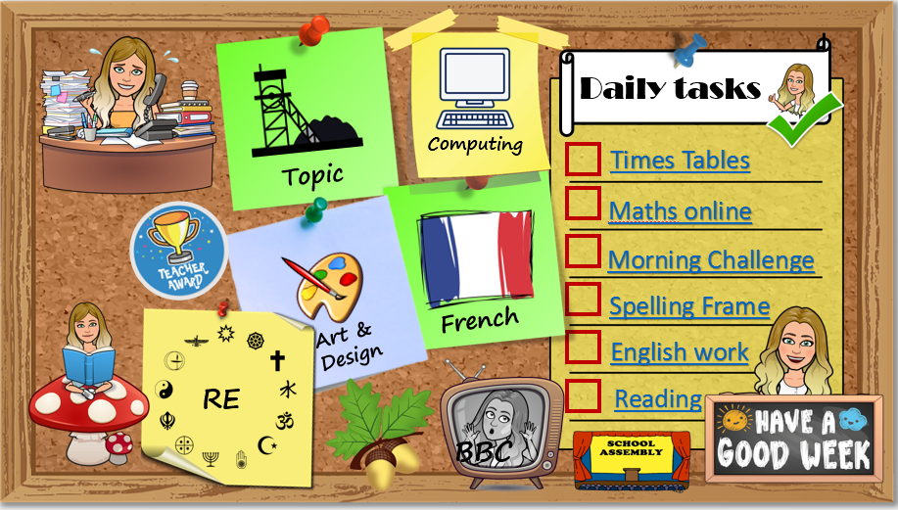
How to use…
Click on the subject icons to visit the slide with more information.
I would like you to choose from the subjects if you can.
Go to Mrs B’s video walkthroughs
I would like you to do these things daily.
Click on the sticker to visit the slide with extra tasks.
Go to Mrs B’s reading page.
Click on the Oak icon to visit The National Oak Academy website.
Click on the TV icon to visit BBC live lessons.
Click on the text to visit the website of your task.
Click the icon to visit the assembly menu.

Slide 3
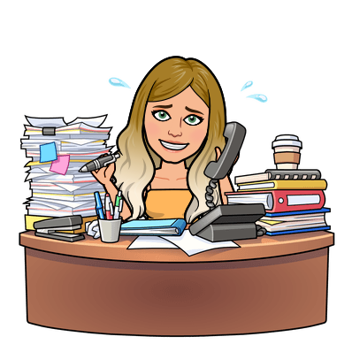






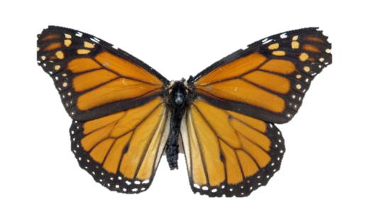








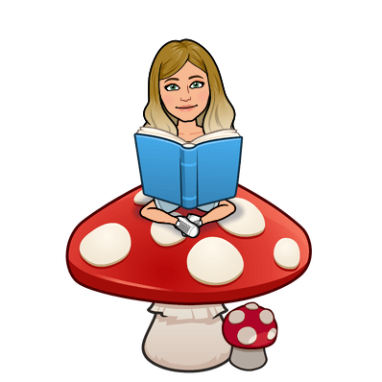




Daily tasks
Computing
Times Tables
Topic
Maths online
Morning Challenge
Spelling Frame
French
Art & Design
English Y5 Y4
RE
Reading
BBC

Slide 4

French
https://www.bbc.co.uk/bitesize/subjects/z39d7ty
We are looking at foods in French this week. https://www.bbc.co.uk/teach/class-clips-video/french-ks2-shopping-for-food/z7ynvk7 Watch the video and listen to the French pronunciation of the pizza ingredients. You may be surprised by some.
Check the dropbox link for resources to support this learning.
Back
To
Menu

Slide 5


Jumpstart Johnny Daily 9am Kimberly Wyatt Dance Wed/Fri 10am Strictly dance 10:30 daily Dance movement 10:30 daily Lifesaving 11am Fridays Shake up 1:30 weekdays Footy fitness 3:30 daily KS2 Ballet 4pm daily Joe Wicks PE 3 times per week at 9am GoNoodle on demand
Remember to stay active!
Back
To
Menu

Slide 6
Children’s liturgy for this week: https://www.youtube.com/watch?v=gMpS4smCUrg
RE
Understanding the mass (Part 1) At the centre of Catholic worship is the Mass. Some Catholics go to Mass on Saturday or Sunday evening; all Catholics are supposed to go to at least one of these services. On entering a Catholic Church, next to the door there is a stoup (a stone bowl) containing Holy Water. This is used to make the sign of the cross with. After making the sign of the cross the person entering the church will then face the altar and kneel down on one knee and make the sign of the cross (genuflect). The Mass will usually have the same pattern every week. During the first part of the Mass there are readings from the ‘Old Testament’ and the ‘New Testament’ of the Bible. In many churches these will be read by different members of the congregation including at times children. Following from this the Priest reads a passage from either Matthew, Mark, Luke or John’s Gospel. This is then followed by the ‘homily’ or teaching by the Priest and prayers will also be said. In some Catholic churches the small children take part in what is known as ‘The Children’s Liturgy’. This is a special group for the children where they think about the Bible story in fun ways. During the second part of the Mass gifts of the bread and wine are offered to God. This is followed by communion. Catholics do not see the breaking of bread just as an act of remembering Jesus’ Last Supper. They believe they relive it. During the time when the Priest offers up the bread and wine, Catholics believe that God changes these everyday objects into the risen Jesus Christ – his body and blood. Because of this, Holy Communion is treated with huge respect in the Roman Catholic church and can’t be offered to people who don’t accept this belief (known as transubstantiation). Design a leaflet that explains mass to a younger child in KS1. We will continue to explore mass next week.
Back
To
Menu

Slide 7

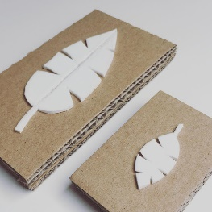
If we were in school, we would be making our own printing blocks this week to print onto cotton. You often find printed designs on fabrics or paper to make cool stationery. We would have been using polystyrene or foam sheets to press our mini-beast designs into but you may not have this at home. Here are some alternative ways to make your own printing stamp:
Potato stamp
https://www.thesprucecrafts.com/how-to-make-stamp-from-potato-2905343
Thick string or cardboard shape prints (Use card if you have no wood)
https://www.wikihow.com/Make-String-Prints
Carve an old eraser
https://www.instructables.com/id/Make-Your-Own-Diy-Custom-Eraser-Stamps/
Print your design onto paper to make some note paper. You could use it to write to a friend or relative.
Art & Design
Back
To
Menu

Slide 8

Science
I’ve added a project to the dropbox for you this week. It involves investigating the best habitat for a mini beast by first building a test centre and then observing behaviour. I’d love to hear which mini beast you observe and if you could send me a picture of your habitats that would be great!
Topic
Creativity
I’d love to hear some limericks from you. You’re all really creative and have a wonderful sense of humour. Look at this page to explore limericks https://www.poetry4kids.com/lessons/how-to-write-a-limerick/. Look at the examples of limericks from the dropbox. Can you use the template to write your own? Once you have written your limerick, think how you can present it. You could make it into a poster or presentation or even a video performance.
Back
To
Menu

Slide 9

Click the icon
and see what
has been
set for you.
There are weekly tasks
that you can access too.
Computing
Back
To
Menu
It is important that we learn to type quickly. It prepares us for life outside of school in the digital world.
https://www.bbc.co.uk/bitesize/topics/zf2f9j6/articles/z3c6tfr

Slide 10





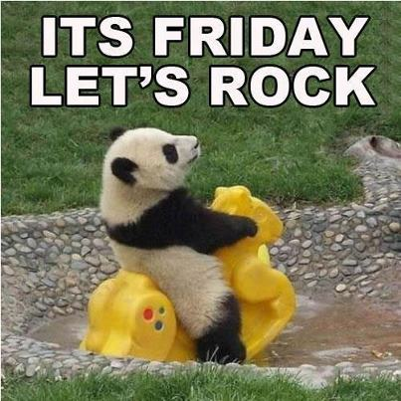
Click on the day you need to see the Morning challenge answers.

Slide 11










Monday
Tuesday
Wed
Thursday
Friday
Back
To
Menu
Week 1
Click on the book covers each day to go to the video of me reading!
(or listen to them together if you can’t wait)
Week 2
Week 3
Week 4
Click onto the next page for our new book
Week 5

Slide 12

Monday
Tuesday
Wed
Thursday
Friday
Back
To
Menu
Week 5
Click on the book covers each day to go to the video of me reading!
(or listen to them together if you can’t wait)
Week 6
Week 7
Week 8

Slide 13
Extra Maths
Gareth Metcalffe maths – daily – 9am
Maths with Carol Vorderman 10am
Daily
Whiterose 10am
Daily
I see maths Daily
Sumdog
Prodigy
Mathletics
Mathsframe
Homeschool History Channel 9:30am
Draw a story 10am M/Tu/W
Music with Myleen Klass M/F 10am
Science daily 10am
Minilingos Spanish 10:30 Tuesdays
Live Art 11am Monday
Body percussion Daily 11am
Hobbycraft craft club daily 11am
Science with Maddie Daily 11am
Techniquest Science daily 12pm
Sign language Daily 1pm
History Wednesday 1pm
Art hub Tuesday 2pm
Bake off 2pm Wed
Life lessons Daily 2pm
Extra English
Authorfy daily 9am
Pie Corbett English daily 9:30
Sentence work daily 9:45
Lit fest daily 10:30
Daily tutor
Back
To
Menu

