Slide 1
Summer Term 2 – Week 4
Hello everyone! I hope you’ve had a great weekend. It looks set to be sunny this week, so enjoy the opportunity to spend some time outdoors with your family. I’ve updated the English link as it seems that The Oak Academy had moved some things on their site. It should now take you directly to this week’s learning.
All of my videos from previous weeks morning challenges remain on the YouTube account and I have kept all hyperlinks to the novel on the slides, in case you need to catch up. It’s great seeing how many views they have knowing that only we have the links.
Quick maths this week is all 4 operations work to keep those skills fresh and there’s nothing in there that should be beyond any of us.
Our Zoom chat is at 11:00 AM on Wednesday, (this repeats weekly) https://us04web.zoom.us/j/73617786652?pwd=emxNZEp2VkZPNUV2ZWJHZTNMbGN0UT09
Meeting ID: 736 1778 6652
Password: StFrancis
Thank you so much for all of the buddy letters so far. I just have a few left to receive. Please can I have these as soon as possible to make sure that your buddy receives them. If it’s easier for you to pop them into school, that is fine, just let me know that you have done that so that I can tick that off my list.
Here’s the Dropbox link for this week: https://www.dropbox.com/sh/5xbxtt1e4eqai08/AAAsdbT-L6C9Xv-sKV6zws2ca?dl=0
Have a great week everyone!

Slide 2
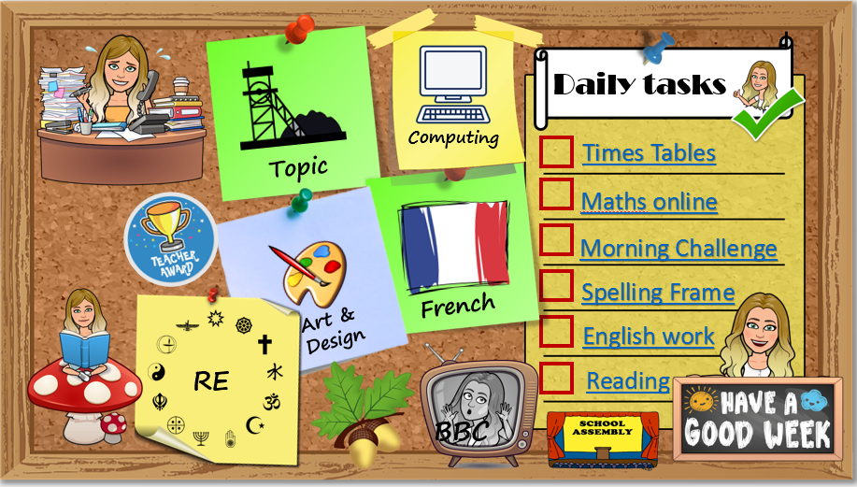
How to use…
Click on the subject icons to visit the slide with more information.
I would like you to choose from the subjects if you can.
Go to Mrs B’s video walkthroughs
I would like you to do these things daily.
Click on the sticker to visit the slide with extra tasks.
Go to Mrs B’s reading page.
Click on the Oak icon to visit The National Oak Academy website.
Click on the TV icon to visit BBC live lessons.
Click on the text to visit the website of your task.
Click the icon to visit the assembly menu.

Slide 3
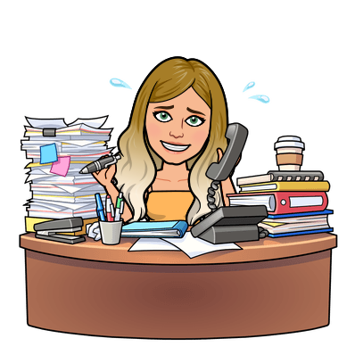






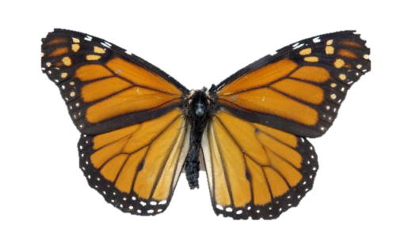













Daily tasks
Computing
Times Tables
Topic
Maths online
Morning Challenge
Spelling Frame
French
Art & Design
English Y5 Y4
RE
Reading
BBC

Slide 4

French
https://www.bbc.co.uk/bitesize/subjects/z39d7ty
We are looking at animals in French this week. Check the dropbox link for some worksheets which you can copy out onto paper, complete in the document or print (Whichever suits you).
https://www.youtube.com/watch?v=OLUrufz-RRA This video will help you with the pronunciation of the French words.
Back
To
Menu

Slide 5


Jumpstart Johnny Daily 9am Kimberly Wyatt Dance Wed/Fri 10am Strictly dance 10:30 daily Dance movement 10:30 daily Lifesaving 11am Fridays Shake up 1:30 weekdays Footy fitness 3:30 daily KS2 Ballet 4pm daily Joe Wicks PE daily 9am GoNoodle on demand
Remember to stay active!
Back
To
Menu

Slide 6
Children’s liturgy for this week:
https://www.youtube.com/watch?v=Zp-unAElqAk
RE
On Pentecost Sunday, when the Holy Spirit descended upon the disciples, they were granted the gifts of the Holy Spirit. Those gifts helped them to fulfil their mission to preach and spread the Gospel to all nations. For us, too, those gifts provide us with the life of God in our souls and help us to live a good Catholic life. Does we know what these gifts are? Wisdom, understanding, counsel, fortitude, knowledge, piety and fear of the Lord. The Holy Spirit will give you these seven gifts at Confirmation. We need to be open to God for the gifts of the Holy Spirit to enter us. Remember, after Jesus’ death on the cross, His disciples were frightened, confused and their hearts and minds were closed. But once they received the Holy Spirit at Pentecost, they were finally open to the promptings of the Spirit. Gifts of the Holy Spirit Wisdom is the gift of the Holy Spirit that helps us to be sensible and not jump to conclusions but be thoughtful. Understanding, makes us smart about our faith and lets the Word of God have an important place in our lives. It helps people to be compassionate and to take time to find out and be able to appreciate what is happening. Right Judgement is the gift that encourages us to talk things over so we can make choices that let us feel comfortable with ourselves afterward. It also help us make the right decisions on our own and offer good advice. Courage to help us walk out into the world and feel prepared to live as a follower of Jesus. It gives us strength and bravery to stand up for what we believe. Knowledge is the Gift of the Holy Spirit that helps us to untie the knots, to straighten out our lives, to deal with problems and live as followers of Jesus. Piety, this is about respect for God, for one another and for yourself. The world and everything in it is precious so we must care for it. San you think of stories from the bible where these gifts are shown? Which story? What happens? How does this display the gifts of the holy spirit?
Back
To
Menu

Slide 7
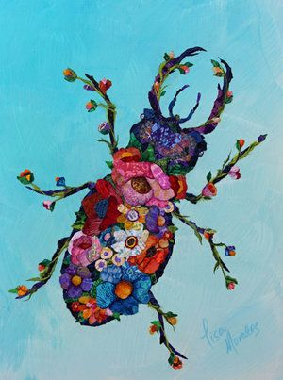
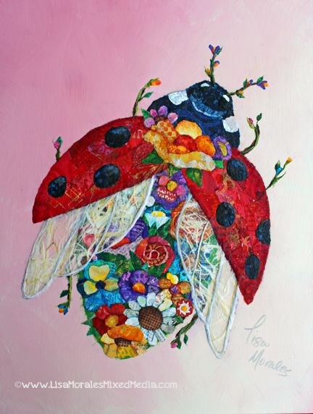
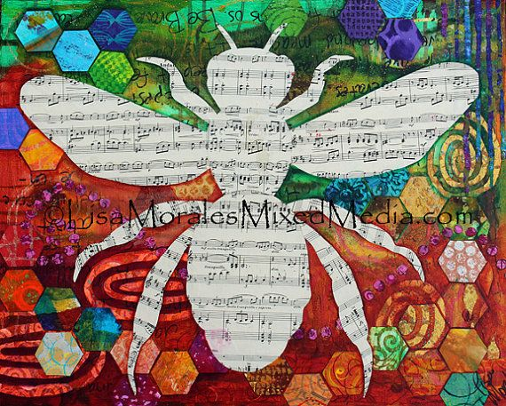
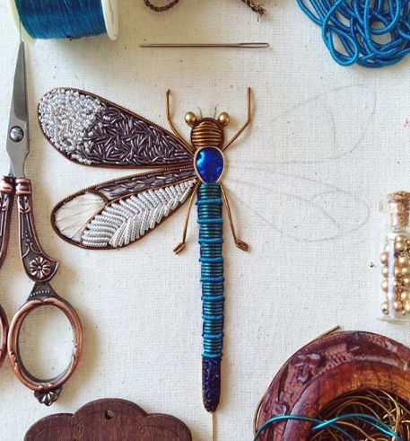
This week I would like you to look at mixed media collage. Mixed media just means different methods of making art. There are some example projects here https://www.happyfamilyart.com/art-lessons/mixed-media-art-lessons/ Lots of artists use mixed media to create texture and depth in their work. Can you find any artists who use this method?
Try showing a minibeast life cycle or making a minibeast picture using a range of materials and methods together in a collage. Which media will you use? Pencils/paint/crayon/paper/sewing/materials/clay…
Art & Design
Back
To
Menu

Slide 8

Science
Our class stick insects are growing well at home with me. We currently have 3 insects, who are female. They have no names yet. I wonder if you could suggest some? One has reached maturity and has began to lay eggs. These eggs will take between 3 and 6 months to hatch and will also be female.
Stick insects are really interesting. All females lay eggs as soon as they are mature and their eggs do not need to be fertilised to produce offspring. All unfertilised eggs will become female offspring. If the egg is fertilised it has a 50% chance of being a male. There are lots more female stick insects than male stick insects because of this.
I would like you to research stick insects this week and produce a ‘how to care for stick insects guidebook’. This will be really useful for me and for anyone who has stick insects in the future. Think about: How long do they take to hatch? What conditions do they live in? What do they eat? What will you need to provide for them? What temperatures do they like? How will they behave? How much care do they need? What is their life cycle? How long do they live? And tell me any interesting facts that you find.
https://www.keepinginsects.com/general-care/ this website may be helpful to you as well as the leaflet in dropbox.
Topic
Back
To
Menu

Slide 9

Why are some lifecycles different?
https://www.bbc.co.uk/teach/class-clips-video/science-ks2--ks3-the-life-cycles-of-different-organisms/zvh8qp3
Back
To
Menu
Topic
Science – Life cycles
Find out about the life cycle of a chosen minibeast. Where did you find your information? Online/books/ebook/leaflet… Watch some of the time-lapse footage videos, from the links here, of minibeast life cycles including stages of metamorphosis.
Produce scientific diagrams to record the life cycles observed, labelling each stage and making simple annotations to describe what happens. (You can do this by drawing or creating digitally)
Time lapse of a butterfly’s metamorphosis
https://www.youtube.com/watch?v=ocWgSgMGxOc
Hercules beetle metamorphosis
https://video.nationalgeographic.com/video/news/00000163-4f88-d2fa-a76b-cfbe22d20000
Ladybird metamorphosis
https://www.youtube.com/watch?v=1He01qvYYzI
What other creatures go through metamorphosis?

Slide 10

Click the icon
and see what
has been
set for you.
There are weekly tasks
that you can access too.
Computing
Can you create a comic strip using your creature design from last week?
What will your creature do? Will it use its enhanced features for good or bad? Who will be its nemesis?
Create a story board ready to write an exciting story.
Back
To
Menu
It is important that we learn to type quickly. It prepares us for life outside of school in the digital world.
https://www.bbc.co.uk/bitesize/topics/zf2f9j6/articles/z3c6tfr

Slide 11





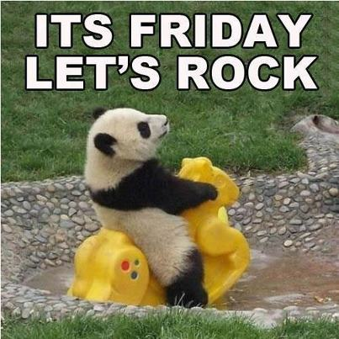
Click on the day you need to see the Morning challenge answers.

Slide 12










Monday
Tuesday
Wed
Thursday
Friday
Back
To
Menu
Week 1
Click on the book covers each day to go to the video of me reading!
(or listen to them together if you can’t wait)
Week 2
Week 3
Week 4

Slide 13
Extra Maths
Gareth Metcalffe maths – daily – 9am
Maths with Carol Vorderman 10am
Daily
Whiterose 10am
Daily
I see maths Daily
Sumdog
Prodigy
Mathletics
Mathsframe
Homeschool History Channel 9:30am
Draw a story 10am M/Tu/W
Music with Myleen Klass M/F 10am
Science daily 10am
Minilingos Spanish 10:30 Tuesdays
Live Art 11am Monday
Body percussion Daily 11am
Hobbycraft craft club daily 11am
Science with Maddie Daily 11am
Techniquest Science daily 12pm
Sign language Daily 1pm
History Wednesday 1pm
Art hub Tuesday 2pm
Bake off 2pm Wed
Life lessons Daily 2pm
Extra English
Authorfy daily 9am
Pie Corbett English daily 9:30
Sentence work daily 9:45
Lit fest daily 10:30
Daily tutor
Back
To
Menu

