Slide 1
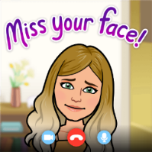
Summer Term 2 – Week 3
Week 3 of this term already! Wow!
Hello everyone, I hope you’ve had a lovely weekend. I’ve loved seeing all of your work on portfolios and through the Dojo messenger. You’re working so hard at this very unusual time, so well done to you all and to your parents. As I mentioned last week, teacher’s are now in school looking after small groups (Bubbles) of children, so won’t be able to get back to you as quickly as they have been but I will answer any messages between 3:30 and 4:30 daily and will be available most of Wednesday, although it does seem to be the day I have lots of meetings. My most important Wednesday meeting is catching up with you! So it would be great to see you at our scheduled zoom: 11:00 AM Every week on Wed, (until Jul 22, I‘ll take suggestions on something special for the end of the year.) https://us04web.zoom.us/j/73617786652?pwd=emxNZEp2VkZPNUV2ZWJHZTNMbGN0UT09
Meeting ID: 736 1778 6652
Password: StFrancis
Can I please ask that Year 4 pupils get their letter/video for their buddy to me ASAP if you haven’t already. The ones I have so far are brilliant!
Here’s the Dropbox link for this week: https://www.dropbox.com/sh/dthkuupajv8its4/AADCb2NtfQvhHdslFy2Jk1Rka?dl=0
Have a great week everyone!

Slide 2
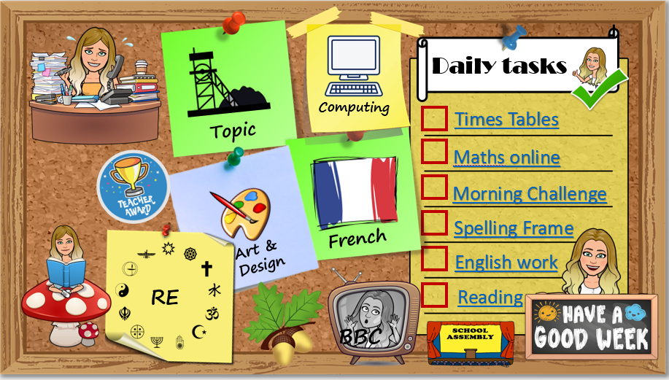
How to use…
Click on the subject icons to visit the slide with more information.
I would like you to choose from the subjects if you can.
Go to Mrs B’s video walkthroughs
I would like you to do these things daily.
Click on the sticker to visit the slide with extra tasks.
Go to Mrs B’s reading page.
Click on the Oak icon to visit The National Oak Academy website.
Click on the TV icon to visit BBC live lessons.
Click on the text to visit the website of your task.
Click the icon to visit the assembly menu.

Slide 3







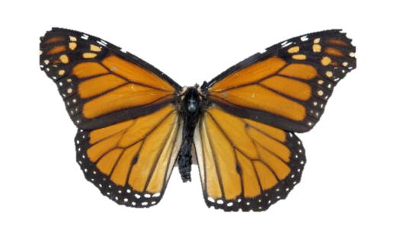











Daily tasks
Computing
Times Tables
Topic
Maths online
Morning Challenge
Spelling Frame
French
Art & Design
English work
RE
Reading
BBC

Slide 4

French
https://www.bbc.co.uk/bitesize/subjects/z39d7ty
https://www.bbc.co.uk/teach/class-clips-video/french-ks2-modern-routines/zjynvk7
Look at the daily routine vocabulary sheet in Dropbox - Listen to the conversation about the daily routine in the link. Can you use your sheet and the visual clues to understand the conversation?
Draw your timetable for the day and add the French sentences to explain.
Can you add the time using your knowledge of numbers?
Back
To
Menu

Slide 5


Jumpstart Johnny Daily 9am Kimberly Wyatt Dance Wed/Fri 10am Strictly dance 10:30 daily Dance movement 10:30 daily Lifesaving 11am Fridays Shake up 1:30 weekdays Footy fitness 3:30 daily KS2 Ballet 4pm daily Joe Wicks PE daily 9am GoNoodle on demand
Remember to stay active!
Back
To
Menu

Slide 6
Back
To
Menu
RE
Children’s liturgy for this week:
https://www.youtube.com/watch?v=q85BSpfWUgs
Our liturgy talked about Jesus giving to us. What do you give to others at school, at home or in your local community? How do you feel when you give to others? Why do we give to others? Being charitable means to give something you have to others. This can be sharing your time, your talents or your money with those in need. We often try especially hard to do many of these things in Lent but we need to try daily…even the small things! This week we will be learning about a certain Saint who often put his faith into action by giving to others. St Francis of Assisi. Our Pope has chosen the name Francis. Look at the life of St Francis of Assisi. How does St. Francis show the qualities needed to be a witness to Jesus? How does he follow the example of the disciples? Is it possible to live in this way as a Christian today? How can we follow the example of St Francis of Assisi and give to others? How did St Francis’ life change? Why was St Francis a Faith Hero? What can we do to be more giving to others like St Francis of Assisi? Create a picture of St Francis of Assisi. Write an explanation of how St Francis changed his life and how his beliefs led to this change. How did he live out his faith using the gifts of the Holy Spirit. Read other bible stories based on giving: Hebrews 6:10 ‘Giving to others’ Mark 12:41-44 ‘The Widow’s Offering’ What questions would you ask these people?

Slide 7
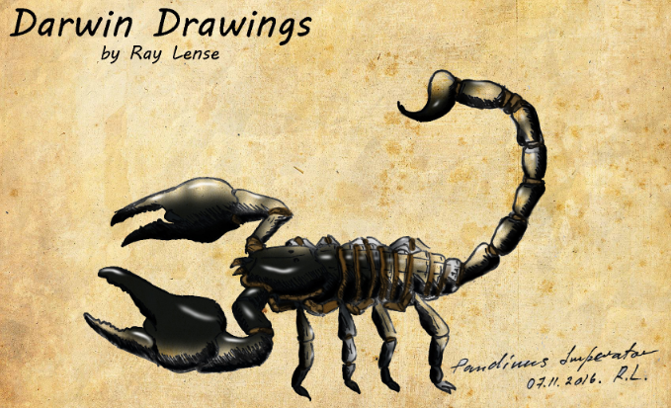
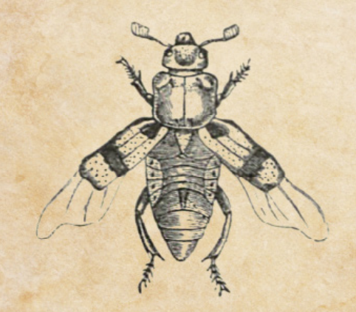
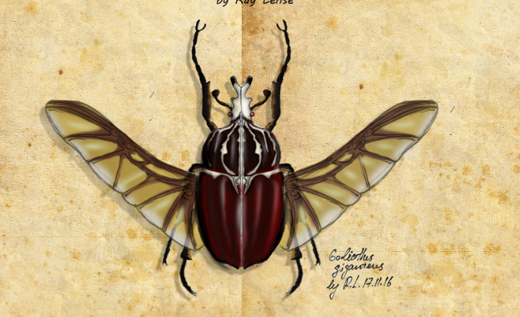
Look at a range of Charles Darwin’s highly detailed drawings of insects and creatures (Dropbox file) made during his investigations. Look at the visual elements evident in Darwin's work. His use of line and shading, colour and tone, how he adds texture and form to create realistic and detailed drawings. Choose a deadly minibeast to draw with close attention to detail, adding tone and texture using pencil, or colour using watercolour paint.
I’ve added some insect symmetry pictures to the dropbox to get you started if you want some help.
Art & Design
Back
To
Menu

Slide 8
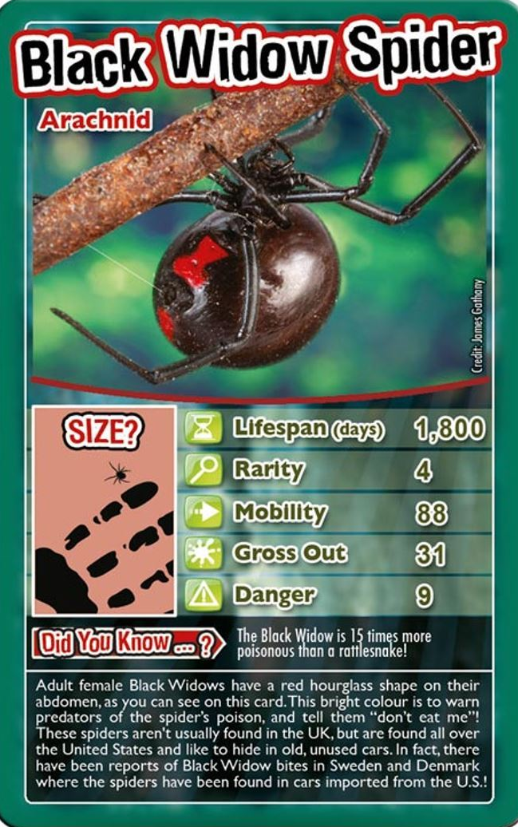



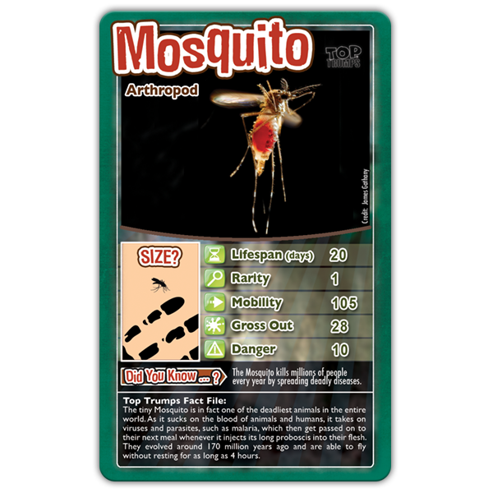
Computer design
This week I would like you to find out (Use the ‘i’ buttons to the right to begin your research), about some of the world’s most deadly creatures including assassin bugs, Asian giant hornets, siafu (safari ants), fire ants, tsetse flies, mosquitoes, Indian red scorpions and the famous black widow spider! Using information collected, design and create your own top trumps card (like the ones on the right). You could make a few and have your own game to play! What design will your cards have? Think about the categories you will include to compare. Which is the most deadly? You could do some writing or a spoken presentation about your chosen creature.
Topic
Back
To
Menu

Slide 9

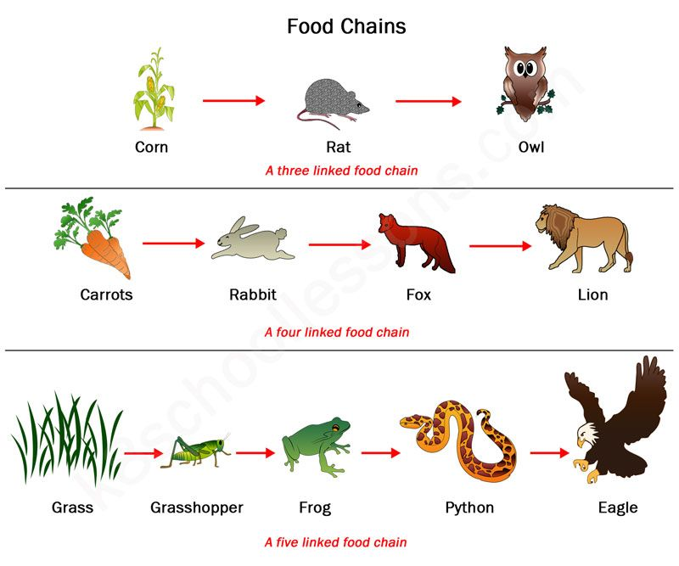
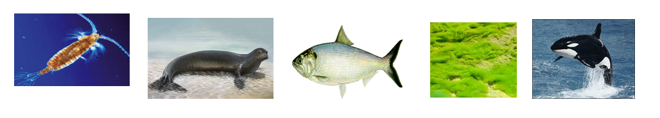
Back
To
Menu
Producer -> Consumer -> Predator
Producer -> Primay consumer -> Secondary Consumer -> Predator
Producer -> Primary Consumer -> Secondary Consumer -> Tertiary Consumer -> Predator
Topic
Science – Food Chains
Use the terms: predator, prey, consumer and producer to sort a group of creatures (Dropbox). Consider and discuss what would happen if one of the living things from the food chain was removed. What would happen if a new predator was introduced to the habitat?
Sort, draw and label this food chain (The green is algae)

Slide 10

Click the icon
and see what
has been
set for you.
There are weekly tasks
that you can access too.
Computing
Use 2paint and 2animate to draw a cartoon version of a most deadly beast. Cartoons often exaggerate the most prominent features of something, like a stinging tail, pincers or great big eyes! Make preliminary drawings in a sketchbook to plan which features could be exaggerated then use purple mash to create, add colour and animate.
Back
To
Menu
It is important that we learn to type quickly. It prepares us for life outside of school in the digital world.
https://www.bbc.co.uk/bitesize/topics/zf2f9j6/articles/z3c6tfr

Slide 11





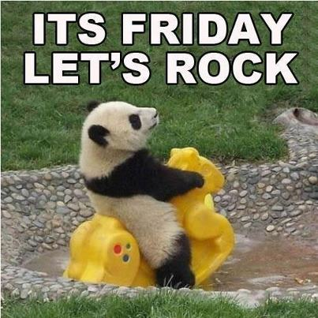
Click on the day you need to see the Morning challenge answers.

Slide 12






Click on the book covers each day to go to the video of me reading!
(or listen to them together if you can’t wait)
Log in and
complete your
comprehension tasks
Read for pleasure
Back
To
Menu
Monday
Tuesday
Thursday
Wed
Friday
Week 1
Week 2
Week 3

Slide 13
Extra Maths
Gareth Metcalffe maths – daily – 9am
Maths with Carol Vorderman 10am
Daily
Whiterose 10am
Daily
I see maths Daily
Sumdog
Prodigy
Mathletics
Mathsframe
Homeschool History Channel 9:30am
Draw a story 10am M/Tu/W
Music with Myleen Klass M/F 10am
Science daily 10am
Minilingos Spanish 10:30 Tuesdays
Live Art 11am Monday
Body percussion Daily 11am
Hobbycraft craft club daily 11am
Science with Maddie Daily 11am
Techniquest Science daily 12pm
Sign language Daily 1pm
History Wednesday 1pm
Art hub Tuesday 2pm
Bake off 2pm Wed
Life lessons Daily 2pm
Extra English
Authorfy daily 9am
Pie Corbett English daily 9:30
Sentence work daily 9:45
Lit fest daily 10:30
Daily tutor
Back
To
Menu

