Slide 1
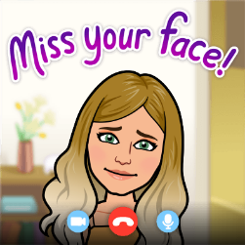
Summer Term 2 – Week 2
Week 2 of a long 7 and a half week term.
I hope you’re enjoying this topic so far. It is honestly one of my favourites, I find insects so fascinating!
Have you tried any of the home learning projects in last week’s Dropbox? https://www.dropbox.com/sh/dfm6gywfe7x3nm6/AAAmb7XvffC_Nt-vj-k_mio7a?dl=0 It’s all still here if you need anything. If you’re finding your Year group’s maths work too easy on White Rose, you can always have a look at what the year above are doing too!
All teacher’s are now in school looking after small groups (Bubbles) of children, so won’t be able to get back to you as quickly as they have been. I will answer any messages between 3:30 and 4:30 daily and will be available most of Wednesday.
It would be great to see you at our scheduled zoom: 11:00 AM Every week on Wed, until Jul 22
https://us04web.zoom.us/j/73617786652?pwd=emxNZEp2VkZPNUV2ZWJHZTNMbGN0UT09
Meeting ID: 736 1778 6652
Password: StFrancis
Here’s the Dropbox link for this week: https://www.dropbox.com/sh/o0ab6i30enulstf/AAA_eMMF6WXBp18vyHfANcJ9a?dl=0
Have a great week everyone!

Slide 2
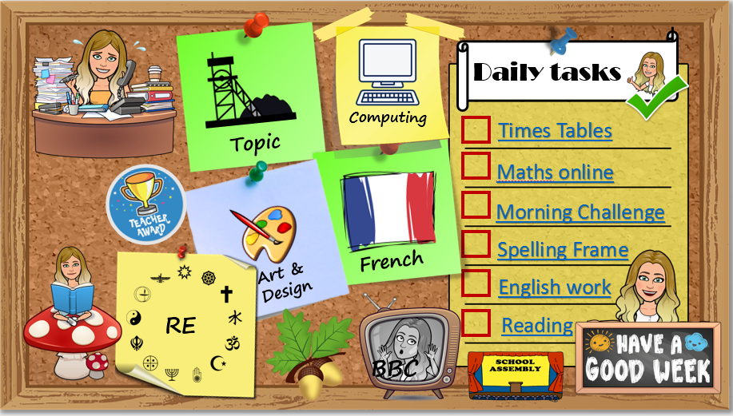
How to use…
Click on the subject icons to visit the slide with more information.
I would like you to choose from the subjects if you can.
Go to Mrs B’s video walkthroughs
I would like you to do these things daily.
Click on the sticker to visit the slide with extra tasks.
Go to Mrs B’s reading page.
Click on the Oak icon to visit The National Oak Academy website.
Click on the TV icon to visit BBC live lessons.
Click on the text to visit the website of your task.
Click the icon to visit the assembly menu.

Slide 3







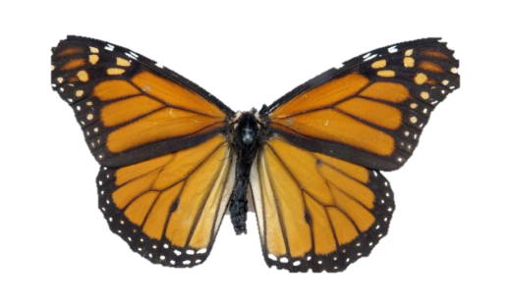











Daily tasks
Computing
Times Tables
Topic
Maths online
Morning Challenge
Spelling Frame
French
Art & Design
English work
RE
Reading
BBC

Slide 4

French
https://www.bbc.co.uk/bitesize/subjects/z39d7ty
https://www.bbc.co.uk/teach/supermovers/ks1--ks2-mfl-french-greetings-with-ben-shires/zdpdvk7
https://www.brilliantpublications.co.uk/upload/gallery/9781905780112-Jaime-Chanter-Alphabet-Francais-song.mp3
Back
To
Menu

Slide 5


Jumpstart Johnny Daily 9am Kimberly Wyatt Dance Wed/Fri 10am Strictly dance 10:30 daily Dance movement 10:30 daily Lifesaving 11am Fridays Shake up 1:30 weekdays Footy fitness 3:30 daily KS2 Ballet 4pm daily Joe Wicks PE daily 9am GoNoodle on demand
Remember to stay active!
Back
To
Menu

Slide 6
Children’s liturgy for this week:
https://www.youtube.com/watch?v=4BQrSkwrzdI
Wednesday Word:
http://www.wednesdayword.org/stopgap/Temporary-Special-Edition.pdf
RE
Back
To
Menu
we will be thinking about how the disciples changed. Read and discuss Peter’s Speech immediately after Pentecost. What key points does Peter make about Jesus and the Spirit? How does this speech include people today? The Holy Spirit is for all, including those far away, Jesus is raised from the dead, we need to ask forgiveness for the things we do wrong, etc. If you were Peter going out to talk to the crowds what would you want to say about Jesus? Imagine that you are one of the disciples going out to another group of people and write a speech. What would you include in your speech? Think about: 1) What has happened? Why are you no longer afraid? (Jesus said this would happen.(look up Mark 9:31-32 and John 14:26)) 2) Tell the crowd about Jesus, use your knowledge of the Gospels to try and say what Jesus was like. 3) Finally tell the crowd what they need to do and how they need to live from now on. To help you write this part of the speech also include the qualities St Paul tells us we should have in Colossians 3:12-17.

Slide 7
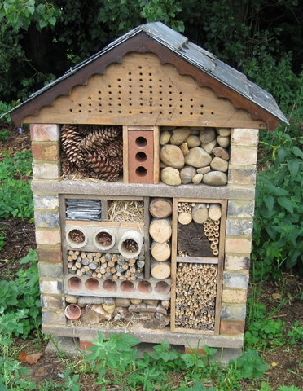
Follow the instructions from the Dropbox folder to make a mini beast hotel. Or design your own on paper if you have no materials.
Once you have built or designed your hotel think about how you could advertise it like a human hotel.
Make a poster or even a video clip!
Look at a range of advertisements for hotel accommodation, analysing the type of words and phrases used to entice customers. Search for examples of common advertisement features in the texts, such as powerful adjectives, informative statements, slogans and use of graphics. Consider how they might entice a range of minibeast customers to come and stay in their hotel! Use powerful adjectives and slogans they could use in a poster advertisement.
Think about attention-grabbing headlines, such as ‘New luxury minibeast hotel opening today!’, ’Five star hotel in the beautiful grounds of Mrs Butt’s house! , ‘Dark, damp and full of nooks and crannies!’
Art & Design
Back
To
Menu

Slide 8

Geography
Use a range of information sources to add mini beasts to the world map (Dropbox). Are there any creatures that only live in certain places? Why do they thrive there?
You can print and illustrate your map with coloured drawings or you can import the map into a document by printing screen and adding digital pictures and information.
Practical science
Try some worm charming. Mark out a square on your grass before starting (500cm by 500cm using lollipop sticks and string is probably a good size). Perform ‘worm charming’ (pour on soapy water and drum your fingers on the ground to mimic rain drops) in this square, collecting and counting each worm that comes to the surface. Predict, using the number of worms in your initial square (0.25m²), how many worms might be present in the whole area you use.
Science
Look at pictures (Dropbox) of shelters that minibeasts make and use. Use the picture cards to match the shelter to the minibeast. Then find out more about each type of shelter using a range of non-fiction books and the web, presenting your findings using labelled diagrams, captions and short paragraphs.
Consider: Who lives in a house like this? What benefit does this structure provide this creature? Do these creatures use these structures throughout their life cycles? What else do you want to find out?
Topic
Back
To
Menu

Slide 9

Click the icon
and see what
has been
set for you.
There are weekly tasks
that you can access too.
Computing
Back
To
Menu
It is important that we learn to type quickly. It prepares us for life outside of school in the digital world.
https://www.bbc.co.uk/bitesize/topics/zf2f9j6/articles/z3c6tfr

Slide 10





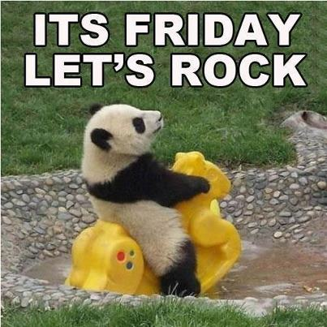
Click on the day you need to see the Morning challenge answers.

Slide 11






Click on the book covers each day to go to the video of me reading!
(or listen to them together if you can’t wait)
Log in and
complete your
comprehension tasks
Back
To
Menu
Read for pleasure
Week 1
Wed
Friday
Monday
Tuesday
Thursday
Week 2

Slide 12
Extra Maths
Gareth Metcalffe maths – daily – 9am
Maths with Carol Vorderman 10am
Daily
Whiterose 10am
Daily
I see maths Daily
Sumdog
Prodigy
Mathletics
Mathsframe
Homeschool History Channel 9:30am
Draw a story 10am M/Tu/W
Music with Myleen Klass M/F 10am
Science daily 10am
Minilingos Spanish 10:30 Tuesdays
Live Art 11am Monday
Body percussion Daily 11am
Hobbycraft craft club daily 11am
Science with Maddie Daily 11am
Techniquest Science daily 12pm
Sign language Daily 1pm
History Wednesday 1pm
Art hub Tuesday 2pm
Bake off 2pm Wed
Life lessons Daily 2pm
Extra English
Authorfy daily 9am
Pie Corbett English daily 9:30
Sentence work daily 9:45
Lit fest daily 10:30
Daily tutor
Back
To
Menu

